Slide 1


The Journey Begins

Slide 3
Public Notice Requirement
The Truth-in-Taxation laws of the State of Texas require notices to be published and hold two public hearings if an entity’s proposed tax rate exceeds the effective or rollback tax rate. The purpose of the public hearings are to give the taxpayers an opportunity to express their views on the tax rate.
For the Fiscal Year 2014-2015, the City of Bastrop 2014 Property Tax Rates are identified as follows:
Proposed Tax Rate: $0.5640/ $100
Preceding Year’s Tax Rate: $0.5840/ $100
Effective Tax Rate: $0.5534/ $100
Rollback Tax Rate: $0.5903/ $100
Initial Tax Rate presented was $0.5840/ $100

Slide 4
City Manager’s Budget Message
CITY SUMMARY
Mission Statement.…..………………………………………………………………………… 9
City of Bastrop History……………………………………………………………………….. 10
City Elected/ Appointed Officials…………………………………………………………... . 13
City of Bastrop Base Map…………………………………………………………....……… 19
Organization Chart……………………………………………………………….................. 21
Departmental Staffing Summary...…………………...…….……………………………..... 23
FINANCIAL SUMMARY
All Fund Summary : Graph of Total Available Resources and Expenditures………… 27
All Fund Summary: Revenues, Expenditures and Changes in Fund Balance….…….…….…… 28
Budgeted Revenues and Expenditures for All Funds Graphs...…………………………. 30
Fiscal Year 2015 Program Requests - Budgeted………………………………………… 35
Revenue Summary..……………...…………….…...………..……..…...………..………… 37
Property Tax Rate Calculations.………………….………………..….………................... 38
Property Tax Rate History…………………………………………………………………. 39
GENERAL FUND
Narrative……………………..………………………………………………………………… 49
FY2015 General Fund Program Requests..……………………………………………….. 51
Revenue Summary..………………………………………………………………………….. 52
Statement of Revenues & Expenditures……......…………………………...…………..... 55
Budgeted Revenues and Expenditure Graphs…………………………………………..... 56
Legislative……….....…………………………...……………………………………………. 61
Organizational...…..…………………………….………………………………………….. 65
City Manager………..……………………………...…………………………………….... 67
City Secretary……..………………………………………………………………………... 72
Finance………………..……………………………..…………………………………….….. 76
Human Resources…..……………………………………………………………………... 82
Information Technology………………………………………………………………………. 86
Police....…………...………………………………………………………….……………….. 90
Fire (Volunteer)...........……………………………………………………….………….…... 99
Municipal Court….....…………...……………………………………………………….….. 103
Planning…………....…………...……………………………………………………….…... 107
Health…..…...……..........……..……………………………………….……………….…... 112
Public Works...…..…….…………………………………………………….………….…... 113
Recreation ...……...…….……………………………………………………………….….. 117
Parks……...…..………..……………………………………………………………….….... 119
Building Maintenance.....………………………………………………………………..….. 123 Library……………….....…………………………………………………………………….. 127
TABLE OF CONTENTS

Slide 5
TABLE OF CONTENTS
PROPRIETARY FUNDS
Water/Wastewater Fund Narrative.…………….…………………………………..…. 133
Statement of Revenues & Expenditures.……….……………………………………... 134
Revenues & Expenditures Fund Charts.……….……………………………………… 135
Department Information………………………….…………………………………........ 136
Bastrop Power & Light Fund Narrative….……..………………………………..…... 147
Statement of Revenues & Expenditures…………………………………………......... 147
Department Information………………………….…………………………………........ 148
SPECIAL REVENUE/ OTHER FUNDS
Bastrop Economic Development Corporation Fund Narrative..…...……………. 155
Statement of Revenues & Expenditures.……….…………………………………….. 156
Department Information………………………….…………………………………....... 157
Bastrop Convention and Exhibit Center Fund Narrative……….………………... 160
Statement of Revenues & Expenditures.……….…………………………………….. 161
Department Information………………………….…………………………………....... 162
Bastrop Main Street Program Fund Narrative………………...….………………... 164
Statement of Revenues & Expenditures.……….…………………………………….. 165
Department Information………………………….…………………………………....... 166
Water/ Wastewater Impact Fee Fund #303….......……………………………………. 169
Water/ Wastewater Acceleration Recovery Fees #304….……..……...………......... 170
Hotel Motel Tax Revenue Fund #501…..……………….……..………………….…… 171
Library Board #505………………………………………………………...………….…. 172
Park/ Trail Land Dedication #520……………………….……...………...………….…. 173
Fairview Cemetery Operating Fund #525/ Permanent Fund #526………………..... 174
Designated Fund #102……………………….……...………...………….…….………. 175
Arts in Public Places Fund #504………………………………………………..……..... 176
Sanitation Fund #310…………………………………….……...………...………….…. 177
DEBT SERVICE
Debt Service Schedules…………………...………………………………..…………… 179
APPENDICES
CIP Work in Progress ………….....…………………..….……………………………... 193
Glossary of Terms..…..............................….…………..…………………………..…. 195
Ordinances Adopting Budget & Tax Rate ..….....……………….….………….…….... 203
DEPARTMENTAL BUDGET REPORTS

Slide 7
City Summary

Slide 9
City of Bastrop Mission Statement
Bastrop is a charming, vibrant, and inclusive community where people are welcomed, valued, and appreciated. With an eye toward the future and becoming a world class city, Bastrop cherishes and protects its rich history and natural resources, and maintains a small town neighborly attitude.

Slide 10
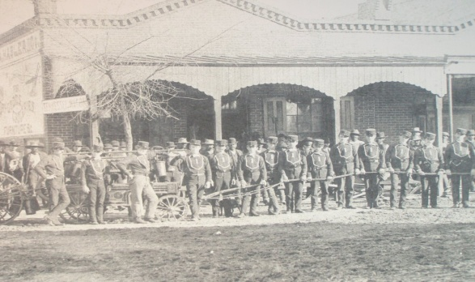
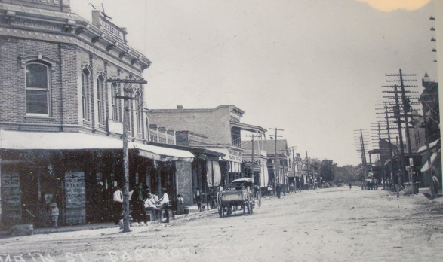
History of Bastrop, Texas
BASTROP, TEXAS, The area was first occupied in 1804, when a fort was established at a strategic Colorado River crossing of the Old San Antonio Road and named Puesta del Colorado.
In 1823, Baron de Bastrop obtained permission from the Spanish to form a German colony, but subsequently failed to establish a settlement. In 1827, Stephen F. Austin established a "Little Colony" of 100 families along the east bank of the Colorado River. The town was probably named Bastrop by Stephen F. Austin in honor of Felipe Enrique Neri, Baron de Bastrop, a longtime friend and business associate. The town was platted in 1832 and settlements continued despite tension with the Indians and Mexican authorities. To accommodate the government of Mexico, the City changed it’s name to Mina. After disagreements and mediation not providing remediation, volunteers joined in the armed uprising against Mexico in 1835-1836.
The town was incorporated under the laws of Texas on December 18, 1837 and the name was changed back to Bastrop. The City was comprised of a courthouse, a hotel, a stockade, a gunsmith shop, a general store, and a number of residences. The pine forest on the westernmost section provided the only timber available in what was then western Texas. The Bastrop timber mills provided lumber for building in Austin, San Antonio and other settlements.
In 1862 fire destroyed most of the downtown buildings located in the 900 block on Main Street. Rebuilding was difficult due to the stress of the war and scarcity of money in the area. To make matters worse, Bastrop experienced a flood of area creeks in 1869, which forced evacuation of the town as waters rose as high as forty-six feet. Fortunately, in 1886 Railroad entered Bastrop bringing trade.

Slide 11
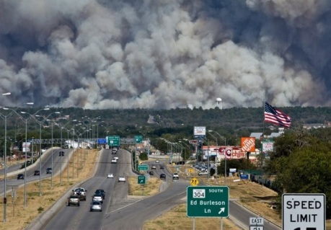

History of Bastrop, Texas continued
The population in Bastrop increased to about 5,000 during World War II, after the establishment of nearby Camp Swift seven miles north of Bastrop. Camp Swift was the largest army training and transshipment camp in Texas at approximately 90,000 troops. When the camp gradually closed after the war, the Bastrop population eventually shrank to 3,158 in 1950.
In 1979, the National Register of Historic Places admitted 131 Bastrop buildings and sites to its listings. This earned Bastrop the title of the "Most Historic Small Town in Texas.” In the 2000 census the population was 5,340 and grew to 7,218 by the 2010 census.
In 2011, the County experienced the Bastrop County Complex Fire that started Labor Day weekend of 2011 which was deemed the most destructive wildfire in Texas history. On September 4, 2011, it is reported that three separate fires merged into a large wildfire that burned east of the City of Bastrop. The fire continued burning until October 9 when fire officials declared the fire was finally 100% contained. The fire forced thousands of evacuations and destroyed 32,400 acres, 1,696 homes and killed 2 people. The Bastrop County Complex Fire is recorded as the third largest wildland urban interface home loss fire to date in the nation.

Slide 13
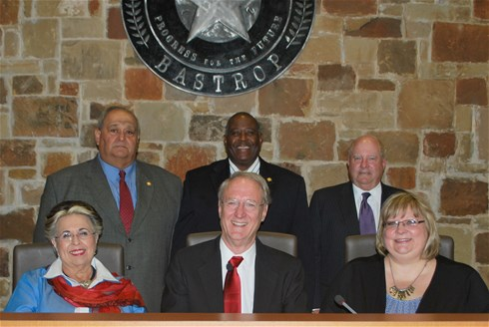
City of Bastrop, Texas
The City of Bastrop is governed by a Council-Manager form of government in which the Council establishes City policy through ordinances and resolutions; and the City Manager carries out City policy and is responsible for City operations. The Bastrop City Council consists of the Mayor and five Council members. The Mayor and Council are elected at-large, which means they represent the entire City and that all registered voters may vote for all six places.
City Council
Term Expires
Ken Kesselus, Mayor May 2017
Willie DeLaRosa, Mayor Pro Tem May 2015
Joe Beal May 2015
Kelly Gilleland May 2016
Kay Garcia McAnally May 2017
Dock Jackson May 2016

Slide 15
Appointed Officials
To assist in the governing process, the City of Bastrop utilizes various boards and commissions. Each board or commission, with a city official liaison, serves an important role and is comprised of citizens who are nominated and appointed by the City of Bastrop City Council. Boards and Commissions identified in alphabetical order.
Arts in Public Places Task Force:
      Vacant Place 1
      Kristi Koch Place 2
      Diana Burley Place 3
      Deborah Johnson Place 4
      Sergio Altamirano Place 5
      Teresa Saunders Place 6
      Hannibal Lokumbe Place 7
Cemetery Advisory Board:
        Ted Schaefer Place 1
        Mary Williams Place 2
        Carl Spooner Place 3
        Terry Sanders Place 4
        Jerry Woehl Place 5
        Cheryl Long Place 6
Construction Standards Board:
        Roger Osborne Place 1
        Bruce Kana Place 2
        David Moore Place 3
        Chase McDonald Place 4
        Charles Schroeder Place 5
        Vacant Alternate #1
        Vacant Alternate #2
Economic Development Corporation Board:
        Pat Crawford Place 1
        Neil Gurwitz Place 2
        Gary Gutierrez Place 3
        Gary Schiff Place 4
        Mayor Ken Kesselus Place 5
        Steve Mills Place 6
        Willie DeLaRosa Place 7
Ethics Commission:
        Chris Duggan – Dist. Judge 423rd Dist. Place 1
        Reverend Lisa Hinds Place 2
        Corporal Wuthipong Tantaksinanukij Place 3

Slide 16
Appointed Officials continued
Historic Landmark Commission:
        Christine Cartwright Place 1
        Dan Hayes Clark Place 2
        Susan Long Place 3
        Blake Kaiser Place 4
        Lisa Patterson Place 5
        Lisa Dougherty Place 6
        Marilyn Whites Place 7
Housing Authority:
        Carlton Harris Place 1
        Andrew Coy Place 2
        Annette Hyder Place 3
        Nettie Kimble Place 4
        Phillip L. Woods Place 5
Hunters Crossing Local Government Information:
        Mike Talbot Place 1
        Bryan Rider Place 2
        Carlos Liriano Place 3
        William Dildine Place 4
        Jim Kershaw Place 5
        Dock Jackson Place 6
        Brandon Johnson Place 7
Impact Fee Committee:
      Lisa Patterson Place 1
      Christy Kosser Place 2
      Tish Winston Place 3
      Lee Bryan Whitten, Jr. Place 4
      Connie B. Schroeder Place 5
      Richard Kindred, Sr. Place 6
      Kristi Koch Place 7
      David Bragg Place 8
      William Ennis Place 9
      Kay Wesson Place 10
Library Board:
        Rebecca Bennett Place 1
        Carolyn Wiginton Place 2
        Mary Jo Jenkins Place 3
        Barbara Clemons Place 4
        Lesa Neese Place 5
        Becky Schaefer Place 6
        Willie Schlickeisen Place 7
        Jamie McDonald Place 8
        Lisa Crick Place 9

Slide 17
Appointed Officials continued
Main Street Advisory Board:
        Vacant Place 1
        Martha Granger Place 2
        Cindye Wolford Place 3
        Keith Goetz Place 4
        Bonnie Coffey Place 5
        Dick Smith Place 6
        Dan Hepker Place 7
        Shawn Anthea-Pletsch Place 8
        Jeanette Condray Place 9
Parks and Public Tree Advisory Board:
      Betty Rucker Place 1
      Lee Harle Place 2
      Mark Gracey Place 3
      Nancy Rabensburg Place 4
      Barbara Wolanski Place 5
      Josh Gordon Place 6
      Vacant Place 7
      William Dildine, Jr. Place 8
      Todd McClanahan-Rep. State Park Place 9
      Youth Rep. Dylan Justice
Planning and Zoning Commission:
      Lisa Patterson Place 1
      Christy Kosser Place 2
      Tish Winston Place 3
      Lee Bryan Whitten, Jr. Place 4
      Connie B. Schroeder Place 5
      Richard Kindred, Sr. Place 6
      Kristi Koch Place 7
      David Bragg Place 8
      William Ennis Place 9
      Kay Wesson Place 10
Red Light Advisory Committee:
        Dock Jackson Place 1
        Joe Beal Place 2
        Kelly Gilleland Place 3
        Kay Garcia McAnally Place 4
        Mayor Pro-TemWillie De La Rosa Place 5
        Warren Pedersen Place 6
Zoning Board of Adjustments/ Municipal Sign Review Board:
    Clifford K. Wright, Sr. Place 1
    Dan Hays-Clark Place 2
    Blas Coy Place 3
    Michael Gibbons Place 4
    Herb Goldsmith Place 5
    Matthew Lassen Alternate #1
    Bob Rogers Alternate #2 2012

Slide 18
Appointed Officials continued
Form Base Code Task Force:
      Kay Garcia McAnally
      Herb Goldsmith
      Dan Hays-Clark
      John Koslowske
      Lisa Patterson
      Bill Peterson
      Michael Talbot

Slide 19
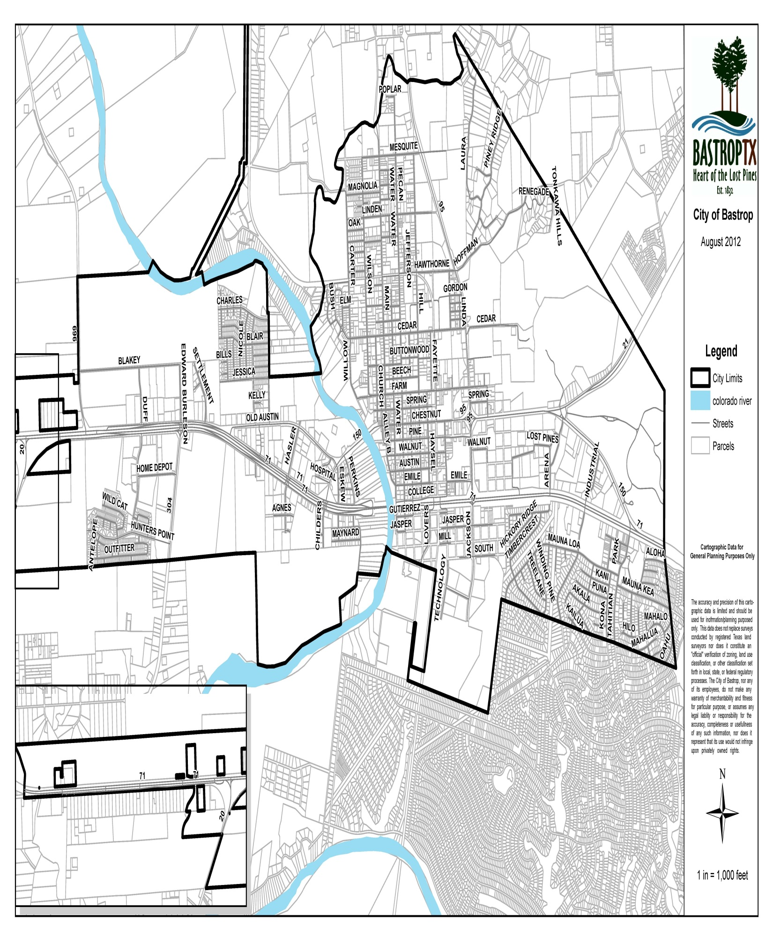
City of Bastrop, Texas Base Map

Slide 21
Current Organizational Chart
FY2014-2015
21
CITIZENS
Mayor / City Council
City Judge
City Manager
City Attorney
Boards and Commissions
Permanent Records
Agendas
Minutes
City Secretary
Human Resources
Employee Benefits
Risk Management
Human Resources
Patrol
Criminal Investigation
Animal Control
Code Enforcement
Emergency
Police Department
Accounting
Finance
Budget
Utility Billing & Collections
Meter Reading
Cemetery
Finance Department
Planning & Zoning
Community Development
Permits & Inspection
Historic Development
Engineering
Planning & Community Development Department
Library Services
Bastrop Public
Library
Fines
Fees
Warrants
Municipal Court
Convention Center
Water Production, Distribution,
and Treatment
Wastewater Collection, Treatment,
and Lift Stations
Bastrop Power & Light
I.T. Department
Historic Preservation
Main Street Program
Water Wastewater
Information
Technology
Services
Main Street
Fire Prevention
Fire Suppression
Fire Department
Streets
Drainage
Parks
Recreation
Custodial Services
Building Maintenance
Public Works
and
Electric Service
Electric Maintenance
Convention Center Rental, Operations and Maintenance

Slide 23
City of Bastrop
Departmental Staffing Summary
PAID PERSONNEL ALL FUNDS
Full-Time Equivalents (FTE)
FUND TYPE | FY 2011-2012 | FY 2012-2013 | FY 2013-2014 | FY 2014-2015
General Fund | 89 | 89.1 | 89.1 | 90.7
Water/Wastewater Utility | 13 | 13 | 13 | 13
Main Street Program | 1 | 1 | 1 | 1
Bastrop Power & Light | 9 | 9 | 9 | 9
Convention Center | 4 | 4.2 | 4.2 | 4.5
Bastrop Economic Development Corporation | 2 | 2 | 2 | 2
Fairview Cemetery | .5 | .5 | 1.5 | 1.5
Total All Funds | 118.5 | 118.8 | 119.8 | 121.7
FTE New Positions: | .1 | .3 | 1 | 2.9*
In Fy2014-2015 there were 2.9 FTE personnel added, however 1 FTE from the Police Department SRO program was reduced as requested by the school district.

Slide 25
Financial Summary

Slide 27
Fiscal Year 2014-2015
All Funds Total Resources and Expenditures

Slide 28
28

Slide 29
29

Slide 30
Fiscal Year 2014-2015
Revenues for All Funds by Category
30
 | FY2014-2015
Ad Valorem Taxes | $ 4,452,240
Sales Taxes | $ 5,145,000
Franchise & Other Taxes | $ 3,092,000
Licenses & Permits | $ 88,000
Service Fees | $ 12,760,845
Fines & Forfeitures | $ 1,010,100
Interest & Other Revenue | $ 36,158
Intergovernmental | $ 2,473,104
Miscellaneous | $ 414,500
Transfers | $ 2,021,959
Total Revenues | $ 31,493,906

Slide 31
Fiscal Year 2014-2015
Revenues for All Funds by Fund Type
Total Revenue $31,493,906

Slide 32
Fiscal Year 2014-2015
Proposed Expenditures for All Funds
by Function
Total Expenditures $31,977,153*
* For comparison purposes, the Proposed Expenditures do not include the Bond Fund Capital Projects.

Slide 33
Fiscal Year 2014-2015
Proposed Expenditures for All Funds
by Fund Type
 | FY 2014-2015 Budget
General Fund | $ 9,937,090
GO Debt Service Funds | $ 2,225,375
Bastrop Economic Development Corp. | $ 1,790,650
Other Special Revenue Funds | $ 5,999,002
Water/ Wastewater Fund | $ 4,271,246
Bastrop Power & Light | $ 7,753,790
Total Expenditures | $ 31,977,153

Slide 35

FY2014-2015 Program Requests
Personnel Additions
Provided 2% COLA adjustment and 2 ½% Step Increase.
Information Technology
Part-time IT Technician - .625 FTE (fulltime equivalent)
Police Department
Two (2) Police Officers - 2 FTE’s
Convention Center
Increase Part-time Event Coordinator to Fulltime - .3 FTE
Equipment/ Vehicle/ Other Additions
General Fund
Information Technology
Software upgrades $5,670
Microsoft Enterprise Agreement $25,325
Battery Backup Replacement $5,000
APX Radio Replacement $6,000
Police Department
Patrol Vehicles (3) $169,500*
Six (6) 800 MHZ Radios $19,900
Nineteen Pistol Mounted Flashlights $2,850
Fire Department
Station 1 Roof and Façade Repair $50,000*
Protective Gear $22,000
Planning Department
Form Based Codes – Zoning Ordinance $130,000*
Comprehensive Plan Update $200,000**
Public Works
Street Improvement $155,000*
Parks
Parks Play scape $33,000*
Parks Master Plan $10,000*
Library
Computers $10,000*
*Funded from Fund Balance
** Funded by BPL

Slide 37
Revenue Summary
PROPERTY, AD VALOREM TAXES attach as an enforceable lien on property as of January 1st of each year. The City’s property tax is levied each October 1st on the assessed value listed as of the prior January 1st for all real and business personal property located in the City. Assessed values are established by the Bastrop County Central Appraisal District at 100% of the estimated market value and certified by the Appraisal Review Board.
The assessed taxable value of the roll on January 1, 2014, upon which the tax levy is based, is $737,922,965. The City is permitted by Article XI, Section 5 of the State of Texas Constitution to levy taxes up to $2.50 per $100 of assessed valuation for general government services including the payment of principal and interest on general obligation long-term debt. The tax rate for the year ending September 30, 2015, is $0.5640 per $100 assessed valuation. The amount allocated for general government operations is $0.3598, while the remaining $0.2042 is allocated for general obligation long-term debt service.
Taxes are due by January 31st following the October 1st levy date and are considered delinquent after January 31st of each year. Based upon historical collection trends, current tax collections are estimated to be 97% of the levy and will generate $4,357,240 in revenues. Delinquent taxes and penalties are expected to add an additional $95,000 in revenues.
In Texas, countywide central appraisal districts are required to assess all property within the appraisal district on the basis of 100% of its appraised value and are prohibited from applying any assessment ratios. The value of property within the appraisal district must be reviewed every five years; however, the City may, at its own expense, require annual reviews of appraised values.
The A Truth-in-Taxation@ laws of the State of Texas require notices to be published and hold two public hearings if an entity’s proposed tax rate exceeds the effective or rollback tax rate. The purpose of the public hearing is to give the taxpayers an opportunity to express their views on the tax rate. The City of Bastrop effective rate is $0.5534/ $100, rollback rate is $0.5903/ $100, and the proposed/ adopted rate is $0.5640/ $100. The proposed rate did exceed the effective or rollback rate therefore the City was required to publish certain notices and hold two public hearings on the tax rate.
37

Slide 38
38
Property Tax Calculations (Ad Valorem Taxes)
 |  |  |  |  | FY2015
 |  |  |  |  | Tax Year 2014
TAX ROLL:
Assessed Valuation (100%) |  |  |  |  | $737,922,965
Rate per $100 |  |  |  |  | 0.56400
Tax Levy Freeze Adjusted |  |  |  |  | 4,161,886
Tax Levy - Frozen (Disabled/ over 65)* |  |  |  |  | 330,115
Total Tax Levy |  |  |  |  | 4,492,001
Percent of Collection |  |  |  |  | 97%
SUMMARY OF TAX COLLECTIONS:
Current Tax |  |  |  |  | 4,037,029
Revenue From Tax Freeze Property |  |  |  |  | 320,211
Delinquent Tax |  |  |  |  | 55,000
Penalty and Interest |  |  |  |  | 40,000
TOTAL TAX COLLECTIONS |  |  |  |  | $4,452,240

Slide 39
Property Tax Rate History
Property Tax Distribution
 | TAX RATE |  | PERCENT |  | TOTAL
GENERAL FUND:
Current Tax | $0.3598 |  |  |  | 2,575,625
Revenue From Tax Freeze Property |  |  |  |  | 204,295
Delinquent Tax |  |  |  |  | 35,750
Penalty and Interest |  |  |  |  | 26,000
Total General Fund | $0.3598 |  | 63.80% |  | $2,841,670
DEBT SERVICE FUND:
Current Tax | $0.2042 |  |  |  | 1,461,403
Revenues From Tax Freeze Property |  |  |  |  | 115,917
Delinquent Tax |  |  |  |  | 19,250
Penalty and Interest |  |  |  |  | 14,000
Total Debt Service | $0.2042 |  | 36.20% |  | $1,610,570
DISTRIBUTION | $0.5640 |  | 100.00% |  | $4,452,240

Slide 40
Property Tax Rate Distribution History
FISCAL YEAR | M & O | I & S | RATE
2005 | $ 0.2050 | $ 0.2961 | $ 0.5011
2006 | $ 0.1902 | $ 0.3375 | $ 0.5277
2007 | $ 0.1834 | $ 0.4001 | $ 0.5835
2008 | $ 0.1952 | $ 0.3398 | $ 0.5350
2009 | $ 0.1992 | $ 0.3548 | $ 0.5540
2010 | $ 0.2292 | $ 0.3248 | $ 0.5540
2011 | $ 0.2889 | $ 0.2651 | $ 0.5540
2012 | $ 0.32027 | $ 0.26373 | $ 0.5840
2013 | $ 0.3504 | $ 0.2336 | $ 0.5840
2014 | $ 0.3638 | $ 0.2202 | $ 0.5840
2015 | $ 0.3598 | $ 0.2042 | $ 0.5640

Slide 41
Annual Sales Tax Receipts – General Fund
Revenue Summary continued.
SALES TAX in the City of Bastrop is collected at a rate of 8.25% of the goods and services sold within the City’s boundaries. The tax is collected by businesses making the sale and is remitted to the State’s Comptroller of Public Accounts on a monthly, and, in some cases, a quarterly basis. The State retains 6.25%, the county retains .5%, BEDC retains .5%, and the remaining 1% is distributed to the City of Bastrop within forty days following the period for which the tax is collected by the businesses.
For the year ending September 30, 2014, the City of Bastrop expects to receive $3,379,000 in sales and use tax revenue in the General Fund. The Bastrop Economic Development Corporation is expected to receive $1,689,500. Fiscal year 2013-2014 recognized a 7.0 percent increase above FY2014 budget levels due to economic growth and the rebuilding resulting from the Bastrop County Complex Fire which occurred in September of 2011.
$3,194,452
$3,155,000
$2,722,333
$3,155,000
$2,606,584
$2,508,969
$2,371,361
$2,170,754
$2,023,821
$1,806,297
41

Slide 42
Revenue Summary continued.
FRANCHISE FEE & OTHER TAXES The City of Bastrop maintains franchise agreements with utilities which use the City’s rights-of-way to conduct their businesses. In addition to defining the responsibilities of the utilities in maintaining their assets, the agreements contain a franchise fee clause which requires the utilities to compensate the City for use of its rights-of way. Total Franchise Fees budgeted for FY2014-2015 total $400,000.
Other Taxes include Hotel/ Motel Tax Receipts, and Hunters Crossing Public Improvement District taxing revenue, Mixed Beverage Tax, and Occupation Tax.
Franchise Fee Receipts– General Fund
LICENSE & PERMIT REVENUE, Business services requiring licenses or permits to operate within the city. Permits are genuinely issued for the location and conduct of business, enterprise, or activities. A permit is required for new construction, repair of existing structures, and alteration of an existing structure including residential, commercial, and industrial. Plans must be submitted for examination and approval, and permit applications must be approved by permits issued by the Building Inspector before construction begins. Licenses and Permits budgeted for FY2014-2015 include Building Permits $75,000, Zoning Fees $3,000, Platting Fees $6,000, and Special Event Permit Fees $2,000.

Slide 43
Revenue Summary continued.
SERVICE FEES
General Fund Service Fee Revenue includes Animal Control Receipts, Parks Receipts, PD Accident Reports, Drug Dog Visit Receipts, and Special Event Reimbursement Receipts.
Water and Wastewater Sales: These Utility fees are funded primarily through user fees. The City’s growing customer base and recent past summer seasons have placed the City’s water utility system under a substantial test as the effects of the aging equipment, and increase of population continue to set new requirements for the delivery of potable water and treatment of wastewater.
ORDINANCE 2014-21:
Water Rates for Residential and Commercial Customers
(Inside City Limits):
Meter Size
3/4" | $ 26.78
1" | $ 45.54
1-1/2“ | $ 76.78
2" | $ 114.28
3" | $ 214.28
4" | $ 246.44
6" | $ 639.30
Consumption per 1,000 gallons
0 - 3,000 | $ 2.75
3,001 - 5,000 | $ 2.94
5,001 - 10,000 | $ 3.11
10,001 - 20,000 | $ 3.30
20,001 - 50,000 | $ 3.57
Over 50,001 | $ 3.74
43

Slide 44
Revenue Summary continued.
Wastewater Rates for Residential and Commercial Customers
(Inside City Limits)
Water Rates for Residential and Commercial Customers
(Outside City limits):
Minimum Charge | $ 26.06
Consumption per 1,000 gallons
0 - 5,000 | $ 2.36
5,001 - 10,000 | $ 2.68
10,001 - 20,000 | $ 2.85
20,001 - 50,000 | $ 3.07
Over 50,001 | $ 3.35
Meter Size
3/4“ | $ 40.18
1" | $ 68.30
1-1/2" | $ 115.19
2" | $ 171.43
3" | $ 321.43
4" | $ 490.19
6" | $ 958.92
Consumption per 1,000 gallons
0 - 3,000 | $ 3.99
3,001 - 5,000 | $ 4.27
5,001 - 10,000 | $ 4.54
10,001 - 20,000 | $ 4.81
20,001 - 50,000 | $ 5.21
Over 50,001 | $ 5.47

Slide 45
Revenue Summary continued.
SERVICE FEES continued
Generally, utility revenue projections are based on five-year forecasting models for each utility. The City prepares a financial model of each utility, forecasting revenues, expected infrastructure needs and other expected expenses. The models are prepared based upon assumptions regarding customer growth, forecasted increases in costs, including personnel, and historical data. The models serve as a planning tool to forecast the ability to pay cash for infrastructure, anticipate debt needs for the upcoming five to ten year period, as well as, predict rate increases for customers.
FINES & FORFEITURES The City of Bastrop Municipal Court charges fines upon conviction of violation of various local and state laws. Revenue accounts include Municipal Court Fines, Administration of Justice, Municipal Court Building Security Fees, Municipal Court Technology Fees, and Juvenile Case Manager fees. Additional Fines & Forfeiture revenue is collected through Sanitation Fees. Fees collected for curbside garbage pick up, including recycling and special pick-ups. The City contracts with Republic Services for garbage service.
INTEREST INCOME The Federal Reserve lowered interest rates over the past year, thus decreasing projected interest revenue. Projections are based on anticipated cash balances from contingency reserves, bond proceeds invested through the life of construction projects and fund balances, as well as, continued existing market conditions.
INTERGOVERNMENTAL REVENUE The City periodically receives funding from federal/ state agencies as the result of new programs, temporary programs or from grant applications. In addition to grants, the City makes in-kind transfers across funds to cover expenditures residing within the general fund.
MISCELLANEOUS REVENUE Revenues not falling into another category are classified as miscellaneous revenue.
45

Slide 47
General Fund

Slide 49
General Fund
The General Fund accounts for resources traditionally associated with governments that are not required to be accounted for in another fund. During the budget process the General Fund receives extensive scrutiny from City staff, City Council, and the public.
The attention is deserved because this fund has many critical issues affecting the community. The issues vary from establishing a tax rate to determining employee staffing and benefits. Operational accomplishments and goals are reported within the departmental narratives in addition to performance measurements.
Departments located within the General Fund include Legislative, Organizational, City Manager’s Office, City Secretary’s Office, Finance, Human Resources, Information Technology, Police, Fire, Municipal Court, Planning, Health, Public Works, Recreation, Parks, Building Maintenance, and Library.

Slide 51
FY2014-2015 Program Requests
Personnel Additions
Provided 2% COLA adjustment and 2 ½% Step Increase.
Information Technology
Part-time IT Technician - .625 FTE (fulltime equivalent)
Police Department
Two (2) Police Officers - 2 FTE’s
Convention Center
Increase Part-time Event Coordinator to Fulltime - .3 FTE
Equipment/ Vehicle/ Other Additions
General Fund
Information Technology
Software upgrades $5,670
Microsoft Enterprise Agreement $25,325
Battery Backup Replacement $5,000
APX Radio Replacement $6,000
Police Department
Patrol Vehicles (3) $169,500*
Six (6) 800 MHZ Radios $19,900
Nineteen Pistol Mounted Flashlights $2,850
Fire Department
Station 1 Roof and Façade Repair $50,000*
Protective Gear $22,000
Planning Department
Form Based Codes – Zoning Ordinance $130,000*
Comprehensive Plan Update $200,000**
Public Works
Street Improvement $155,000*
Parks
Parks Play scape $33,000*
Parks Master Plan $10,000*
Library
Computers $10,000*
*Funded from Fund Balance
** Funded by BPL

Slide 52
GENERAL FUND
REVENUE SUMMARY
 | 2012-2013 | 2013-2014 | 2013-2014 | 2014-2015
 | ACTUAL | BUDGET | PROJECTED | BUDGET
TAXES & PENALTIES
00-00-4001 CURRENT TAXES M&O | 2,337,740 | 2,567,343 | 2,567,343 | 2,779,920
00-00-4002 DELINQUENT TAXES M&O | 40,571 | 34,265 | 34,265 | 35,750
00-00-4003 PENALTIES & INTEREST M&O | 33,508 | 27,412 | 27,412 | 26,000
00-00-4004 FRANCHISE TAX | 412,730 | 400,000 | 400,000 | 400,000
00-00-4006 CITY SALES TAX | 3,322,116 | 3,155,000 | 3,379,000 | 3,430,000
00-00-4008 OCCUPATION TAX | 6,115 | 5,000 | 10,000 | 8,000
00-00-4009 MIXED BEVERAGE TAX | 30,149 | 20,000 | 22,000 | 20,000
 | ____________ | ____________ | ____________ | ____________
TOTAL | 6,182,929 | 6,209,020 | 6,440,020 | 6,699,670
LICENSES & PERMITS
00-00-4020 BUILDING PERMITS | 112,140 | 75,000 | 75,000 | 75,000
00-00-4021 ZONING FEES | 1,956 | 3,000 | 3,000 | 3,000
00-00-4022 PLATTING FEES | 19,590 | 6,000 | 6,000 | 6,000
00-00-4023 SPECIAL EVENT PERMIT FEE | 1,800 | 2,000 | 2,000 | 2,000
 | ____________ | ____________ | ____________ | ____________
TOTAL | 135,486 | 86,000 | 86,000 | 86,000
CHARGES FOR SERVICES
00-00-4040 ANIMAL SERVICE RECEIPTS | 435 | 200 | 200 | 200
00-00-4043 PARKS RECEIPTS | 1,065 | 1,600 | 1,600 | 1,600
00-00-4044 PD ACCIDENT REPORTS | 2,633 | 1,800 | 2,000 | 1,800
00-00-4046 SPECIAL EVENTS HOT RE. | 28,362 | 40,800 | 40,800 | 35,000
00-00-4049 TRANSFER STATION RCPTS | 8,775 | 10,000 | 7,000 | 7,000
 | ____________ | ____________ | ____________ | ____________
TOTAL | 41,270 | 54,400 | 51,600 | 45,600
FINES & FORFEITURES
00-00-4070 MUNICIPAL COURT FINES | 241,225 | 225,000 | 175,000 | 175,000
00-00-4072 SANITATION PENALTY/RECON | 3,267 | 0 | 0 | 0
00-00-4076 LIBRARY RECEIPTS | 17,120 | 16,000 | 16,000 | 16,000
00-00-4077 SANITATION PROCEEDS | 40,888 | 0 | 0 | 0
00-00-4078 JUVENILE CASE MGR-M/C | 7,481 | 5,100 | 5,100 | 5,100
00-00-4080 TEEN COURT-M/C | 1,703 | 1,000 | 1,000 | 1,000
 | ____________ | ____________ | ____________ | ____________
TOTAL | 311,684 | 247,100 | 197,100 | 197,100

Slide 53
REVENUE SUMMARY – PAGE 2
 | 2012-2013 | 2013-2014 | 2013-2014 | 2014-2015
 | ACTUAL | BUDGET | PROJECTED | BUDGET
OTHER REVENUE
00-00-4391 STREET/ROW VACATIONS | 0 | 0 | 0 | 0
 | ____________ | ____________ | ____________ | ____________
TOTAL | 0 | 0 | 0 | 0
INTEREST INCOME
00-00-4400 INTEREST RECEIPTS | 6,227 | 6,000 | 4,000 | 5,000
 | ____________ | ____________ | ____________ | ____________
TOTAL | 6,227 | 6,000 | 4,000 | 5,000
INTERGOVERNMENTAL
00-00-4411 BASTROP CO/LIBRARY | 8,500 | 0 | 0 | 0
00-00-4413 BISD PROJECT RECEIPTS | 65,479 | 50,000 | 58,500 | 40,000
00-00-4414 DEPT OF JUSTICE GRANT | 1,650 | 0 | 0 | 0
00-00-4415 EMERGENCY MANAGEMENT | 27,626 | 20,000 | 30,000 | 30,000
00-00-4419 PROPERTY LIEN PAYMENTS | 1,122 | 0 | 12,000 | 0
00-00-4490 ELECTRIC IN-KIND | 516,280 | 516,280 | 516,280 | 516,280
00-00-4491 WATER/WASTEWATER IN-K | 531,020 | 531,020 | 531,020 | 531,020
00-00-4493 BEDC IN-KIND | 199,080 | 169,080 | 169,080 | 169,080
00-00-4495 CONVENTION CENTER IN-K | 174,120 | 174,120 | 174,120 | 174,120
 | ____________ | ____________ | ____________ | __________
TOTAL | 1,524,877 | 1,460,500 | 1,491,000 | 1,460,500
MISCELLANEOUS
00-00-4509 GENERAL DONATIONS | 3,360 | 0 | 1,000 | 0
00-00-4512 SALE OF FIXED ASSETS | 11,625 | 0 | 7,000 | 0
00-00-4522 WORKERS COMP. REIMBURSE | 7,259 | 4,000 | 1,200 | 4,000
00-00-4524 SPLASHPARK DONATIONS | 10,000 | 0 | 0 | 0
00-00-4536 MISCELLANEOUS | 85,242 | 21,550 | 21,000 | 21,000
00-00-4537 INSURANCE PROCEEDS | 14,600 | 15,152 | 0 | 0
 | ___________ | ____________ | ____________ | ____________
TOTAL | 132,086 | 40,702 | 30,200 | 25,000
TRANSFERS-IN
00-00-4703 TRANSFERS IN - ELECTRIC | 613,500 | 613,500 | 613,500 | 613,500
00-00-4706 TRANSFERS IN – SPECIAL PROJECT | 0 | 0 | 0 | 200,000
00-00-4708 TRANSFER IN –SANITATION FUND | 0 | 48,000 | 48,000 | 48,000
 | ____________ | ____________ | ____________ | ____________
TOTAL | 613,500 | 661,500 | 661,500 | 613,500
TOTAL REVENUE | $ 8,948,058 | $ 8,765,222 | $ 8,961,420 | $9,380,370

Slide 56
FY 2014-2015
General Fund Revenues by Category
56
General Fund | FY 2014-2015 Budget
Ad Valorem Taxes | $ 2,841,670
Sales Taxes | $ 3,430,000
Franchise & Other Taxes | $ 428,000
Licenses & Permits | $ 86,000
Service Fees | $ 45,600
Fines & Forfeitures | $ 245,100
Interest & Other Revenue | $ 5,000
Intergovernmental | $ 1,460,500
Miscellaneous | $ 225,000
Transfer In | $ 613,500
Total Proposed Revenues | $ 9,380,370

Slide 57
FY 2014-2015
General Fund Expenditures by Function
General Fund | FY 2014-2015 Budget
General Government | $ 4,283,450
Public Safety | $ 3,321,510
Development Services | $ 893,790
Community Services | $ 1,438,340
Total Proposed Expenditures | $ 9,937,090

Slide 59
General Fund Departmental Summaries

Slide 61
LEGISLATIVE
Department Description
Appoints the City Manager, City Attorney, Municipal Court Judge and various citizen boards and commissions.
Adopts the annual budget of the City and approves purchases and contracts as prescribed by the City Charter and State Law.
Reviews/adopts all City ordinances and resolutions.
Adopts the City’s ad valorem tax rate and authorizes the issuance of bonds.
Establishes the fees and rates for City goods and services.
Department Location
The City Council is located in City Hall at 1311 Chestnut Street, Bastrop, Texas 78602.
The meetings are held at 6:30 p.m. on the 2nd and 4th Tuesday of each month.
You may contact the City Manager or City Secretary, who will contact the City Council, by phone at (512) 332-8800, or you may write the Mayor or Council at P.O. Box 427, Bastrop, Texas 78602.
Expenditure Summary | FY 2012-2013 | FY 2013-2014 | FY 2013-2014 | FY 2014-2015
Classification | Prior YTD | Original Budget | Projected YTD | Budget
Personnel | 5,261 | 5,970 | 5,970 | 5,970
Supplies | 3,829 | 4,900 | 4,650 | 4,530
Maintenance | 0 | 0 | 0 | 0
Occupancy | 6,710 | 8,000 | 8,000 | 8,000
Contractual | 2,136 | 1,800 | 2,100 | 11,800
Other Charges | 9,284 | 16,040 | 15,645 | 19,940
Total | $27,219 | $36,710 | $36,365 | $50,240

Slide 62


LEGISLATIVE continued
2013-2014 Accomplishments
• Started Form-Based Codes project for zoning in FY14, anticipate completion in FY15.
Reviewed Hotel Occupancy Tax (HOT) Funding.
Continued to develop and implement Short-term and Long-term Water Plan Strategy for the City of Bastrop.
2014-2015 Goals
• Maintain good relations with surrounding communities in order to promote regional efforts.
• Continue to seek out community friendly businesses to locate within the city limits while
working with the BEDC.
• Continue to make Bastrop the best community in the nation through preservation of the past
and progress for the future.
• Continually evaluate maintenance and operational efficiencies in city wide operation.
Develop programs that enhance available resources within city staff to better serve the citizens of the City of Bastrop.
Continue to implement and develop Strategic Planning Priorities provided at the City Council Planning Retreat.
62

Slide 63


LEGISLATIVE continued
Performance Measurement Indicators | FY 2011-2012 | FY 2012-2013 | FY2013-2014 | FY2014-2015
Demand
City Population | 7,500 | 7,650 | 7,800 | 7,950
Number of City Council Meetings Number of City Council Members Number of City Departments | 38 6 29 | 35 6 29 | 40 6 29 | 40 6 29
Input
Operating Expenditures | $33,105 | $27,219 | $36,365 | $50,240
Output
Number of Resolutions Adopted | 25 | 25 | 20 | 10
Number of Ordinances Adopted | 20 | 30 | 26 | 20
Number of Proclamations | 17 | 20 | 20 | 20
Number of Annexations | 1 | 0 | 0 | 0
Photo of City Council: Top Left: Mayor Pro-tem Willie DeLaRosa, Dock Jackson, Joe Beal
Bottom Left: Kay Garcia McAnally, Mayor Ken Kesselus, Kelly Gilleland

Slide 65
ORGANIZATIONAL
Department Description
To administer expenditures related to the overall organization including legal, professional, 380 agreements, retiree benefits, tax appraisal and tax collection services.
Department Location
City Manager and the Chief Financial Officer oversee the programs established in the
Organizational section of this budget. Their offices are in City Hall at 1311 Chestnut
Street, Bastrop, Texas 78602.
Hours are 8:00 AM to 5:00 PM, Monday through Friday, excluding holidays.
You may contact staff by phone at (512) 332-8800.
Expenditure Summary | FY 2012-2013 | FY 2013-2014 | FY 2013-2014 | FY 2014-2015
Classification | Prior YTD | Original Budget | Projected YTD | Budget
Personnel Services | 120,751 | 140,000 | 167,840 | 182,580
Supplies | 13,966 | 15,290 | 12,830 | 14,990
Maintenance | 6,059 | 6,660 | 5,540 | 7,160
Occupancy | 0 | 0 | 0 | 0
Contractual Services | 524,241 | 442,070 | 482,070 | 433,570
Other Charges | 371,930 | 394,320 | 421,820 | 450,865
Contingency | 0 | 325,000 | 0 | 207,615
Capital | 17,402 | 22,000 | 22,500 | 0
Total | $1,054,348 | $1,345,340 | $1,112,600 | $1,296,780

Slide 67
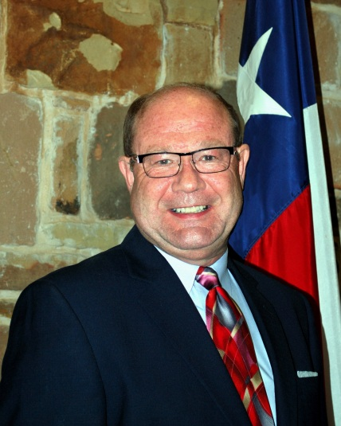
CITY MANAGER
Department Description
To administer all departments, functions, and municipal business of the City.
To oversee the day-to-day operations of the City through direction of and coordination with department heads and staff.
To make reports and recommendations to the City Council regarding present and future needs of the City.
To represent the interests and positions of the City in dealing with other government entities and agencies, with various business interests, and with the community at large.
To take charge of any catastrophic event occurring within the City limits, utilizing use of “emergency incident command” training.
Department Location
The City Manager is located in City Hall at 1311 Chestnut Street, Bastrop, Texas 78602.
Hours are 8:00 AM to 5:00 PM, Monday through Friday, excluding holidays.
You may contact the City Manager by phone at (512) 332-8800.
Expenditure Summary | FY 2012-2013 | FY 2013-2014 | FY 2013-2014 | FY 2014-2015
Classification | Prior YTD | Original Budget | Projected YTD | Budget
Personnel Services | 311,564 | 284,100 | 287,389 | 290,460
Supplies | 5,638 | 5,550 | 4,398 | 6,450
Maintenance | 0 | 0 | 0 | 0
Occupancy | 7,161 | 8,760 | 8,260 | 9,400
Contractual Services | 166 | 350 | 108 | 350
Other Charges | 8,814 | 10,140 | 11,430 | 11,740
Total | $333,344 | $308,900 | $311,585 | $318,400

Slide 68
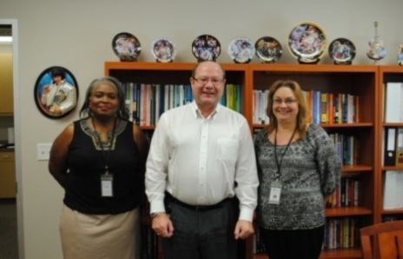
CITY MANAGER continued
2013-2014 Accomplishments
• Developed Short-term and Long-term Water Supply alternatives for City.
• President of the Board of Directors for Lost Pines Groundwater Conservation District.
• Expanding Partnership with YMCA for the City of Bastrop.
• New tenants Chick-fil-A and Academy Sports to Burleson Crossing.
Historical Landmark Commission Ordinance completed.
La Hacienda Restaurant opened.
2014-2015 Goals
• Continue to oversee and negotiate expected growth in West Bastrop area.
• Promote progress of City infrastructure projects: streets, piping, parks, electrical lines, and new water wells.
• Advance CIP’s to fruition.
• Ensure sound City Obligation Bonds; keep ratings high.
• Continue MUD negotiations for Bastrop Village in ETJ.
• Water Treatment Plant #3 plans “on hold” for future improvement.
• Continue PID work on Hunters Crossing.
• Thoroughfare Plan nearing completion.
• Future Land Use Plan nearing completion.
• Purcell Pointe and Jackson Square projects progressing (Hwy 71 & 95).
• Persist in seeking clean and productive Water Sources for the City’s future predicted growth.
2014-2015 Budget Objectives
• Oversee and dispense General Fund Budget to best apply funds where needed.
• Approve and distribute City Manager’s budget for both City Manager, (1) CM Executive Assistant, and (1) City Manager Receptionist as needed.

Slide 69
CITY MANAGER continued
Performance Measurement Indicators | FY 2011-2012 | FY2012-2013 | FY2013-2014 | FY2014-2015
Demand
City Population | 7,500 | 7,650 | 7,800 | 7,950
Number of City Council Meetings Number of City Council Members Number of City Departments | 38 6 29 | 35 6 29 | 40 6 29 | 40 6 29
Input
Operating Expenditures | $300,961 | $333,344 | $311,585 | $318,400
Total Number of Personnel (FTE) | 2.625 | 2.625 | 2.625 | 2.625
Output
City Council Meetings | 38 | 35 | 40 | 40
Plan Review Meetings | 45 | 45 | 45 | 45
Public Works Meetings | 48 | 48 | 48 | 48
Staff Agenda Meetings | 48 | 48 | 48 | 48
Legal Review Meetings | 40 | 40 | 35 | 30
Workshops/ Special Other Meetings | 15 | 15 | 16 | 16
Retreats | 2 | 2 | 2 | 2
Public Hearings | 20 | 20 | 25 | 30
TV Show Tapings | 24 | 24 | 15 | 24
Efficiency
City Manager Expenditures as % of General Fund | 3.68% | 3.57% | 3.37% | 3.2%
FTE as % of General Fund FTE | 2.95% | 2.95% | 2.95% | 2.89%
Ordinances | 20 | 30 | 26 | 20
Resolutions | 25 | 25 | 20 | 10
Effectiveness
Various Grants | 4 | 10 | 6 | 6
TPWD Grants | 1 | 2 | 1 | 0
Agreements (Various) | 40 | 40 | 40 | 30
% of Minutes Approved -14 days | 100% | 100% | 100% | 100%

Slide 70
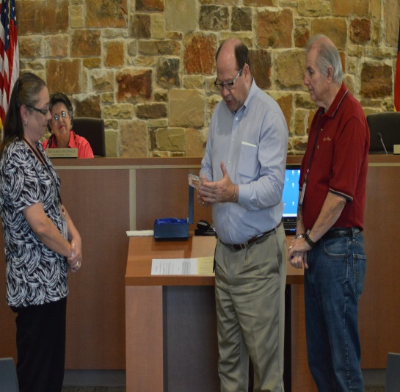
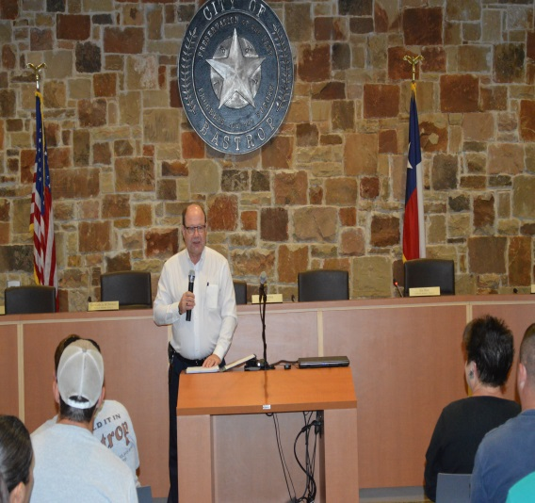
CITY MANAGER continued
Staffing Summary | FY 2011-2012 | FY 2012-2013 | FY 2013-2014 | FY 2014-2015
City Manager | 1 | 1 | 1 | 1
Executive Assistant | 1 | 1 | 1 | 1
Receptionist | .625 | .625 | .625 | .625
Total | 2.625 | 2.625 | 2.625 | 2.625
CITY MANAGER ORGANIZATIONAL CHART
City Manager
Executive Assistant
Receptionist

Slide 72
CITY SECRETARY
Department Description
Prepares & maintains the Agendas & Minutes of all City Council Meetings.
Prepares & maintains ordinances, resolutions, proclamations & election orders.
Acts as Chief Election Officer.
Serves as records management officer, responsible for preservation of the City’s records,
including storage, retention and destruction.
Keeps current in the changes of the law & technology & the practices of job
responsibilities through continued participation in professional associations and education.
Department Location
The City Secretary is located in City Hall at 1311 Chestnut Street, Bastrop, Texas 78602
Hours are 8:00 AM to 5:00 PM, Monday through Friday, excluding holidays
You may contact the City Secretary by phone at (512) 332-8811 or (512) 332-8800.
Expenditure Summary | FY 2012-2013 | FY 2013-2014 | FY 2013-2014 | FY 2014-2015
Classification | Prior YTD | Original Budget | Projected YTD | Budget
Personnel Services | 64,655 | 62,060 | 69,155 | 71,180
Supplies | 1,479 | 1,490 | 1,515 | 5,975
Maintenance | 0 | 0 | 0 | 0
Occupancy | 1,081 | 2,070 | 2,070 | 2,190
Contractual Services | 2,377 | 5,100 | 5,000 | 5,600
Other Charges | 23,893 | 34,380 | 30,120 | 40,490
Total | $93,486 | $105,100 | $107,860 | $125,435

Slide 73

CITY SECRETARY continued
2013-2014 Accomplishments.
• Incorporating the coordination of Special Events
Uploading the following to the City Website – Agendas, Agenda Packets, Ordinances, Resolutions, Annual Meeting Calendar
2014-2015 Goals
• Provide continued professional support for City Council Meetings.
• Contract with Bastrop County Elections Administrator for City Elections conducted according to current mandated State Law.
• Continue education and training in Elections process and attend the Texas Secretary of State and the TMCCP Elections training
• Create data source for all records to mail monthly permit expiration reminders.
• Create an efficient online submission process for Open Records Request
• Convert all records to electronic files
2014-2015 Budget Objectives
• Reduce paper use by 30% by using electronic sources
• Continue to place items on the City’s Web Page.

Slide 74
CITY SECRETARY continued
Performance Measurement Indicators | FY 2011-2012 | FY 2012-2013 | FY 2013-2014 | FY 2014-2015
Demand
City Population | 7,500 | 7,650 | 7,800 | 7,950
Number of City Council Meetings Number of City Council Members Number of City Departments | 38 6 29 | 35 6 29 | 40 6 29 | 40 6 29
Input
Operating Expenditures | $106,720 | $105,584 | $107,860 | $125,435
Total Number of Personnel (FTE) | 1 | 1 | 1 | 1
Output
Number of Agendas | 38 | 35 | 40 | 40
Number of Certified Agendas | 26 | 22 | 30 | 30
Number of Minutes | 38 | 38 | 40 | 40
Number of Resolutions | 25 | 25 | 20 | 20
Number of Ordinances | 20 | 30 | 26 | 26
Number of Proclamations | 17 | 20 | 20 | 20
Number of Elections | 3 | 1 | 1 | 1
Efficiency
City Secretary Expenditures as % of General Fund | 1.30% | 1.24% | 1.15% | 1.2%
FTE as % of General Fund FTE | 1.1% | 1.1% | 1.1% | 1.1%

Slide 75
CITY SECRETARY continued
Staffing Summary | FY 2012-2013 | FY 2013-2014 | FY 2013-2014 | FY 2014-2015
City Secretary | 1 | 1 | 1 | 1
Total | 1 | 1 | 1 | 1
CITY SECRETARY ORGANIZATIONAL CHART
City Secretary

Slide 76


FINANCE DEPARTMENT
Department Description
The Finance Department consists of Finance, Accounting, Cemetery Administration, Utility Customer Service, and Meter Services.
Accounting is responsible for managing the financial affairs of the City. This includes payroll, accounts receivable, accounts payable, fixed assets, inventory, audit, revenue collection and reconciliation, cash management, and debt management.
Cemetery Administration is responsible for the management and oversight of the Fairview Cemetery.
Utility Customer Service/ Meter Services is the meter reading, billing and collections of the City owned utilities and the Sanitation service offered by Republic Services.
Department Location
Finance is located in City Hall at 1311 Chestnut Street, Bastrop, Texas 78602.
Hours are 8:00 AM to 5:00 PM, Monday through Friday, excluding holidays. Utility
Customer Service offers extended hours as a convenience to our customers.
You may contact the staff by phone at (512) 332-8820. Utility Customer Service staff may
be contacted by phone at (512) 332-8830.
Expenditure Summary-Finance | FY 2012-2013 | FY 2013-2014 | FY 2013-2014 | FY 2014-2015
Classification | Prior YTD | Original Budget | Projected YTD | Budget
Personnel Services | 300,524 | 317,810 | 326,966 | 327,224
Supplies | 2,869 | 9,810 | 8,000 | 9,440
Maintenance | 33,446 | 38,000 | 38,000 | 38,000
Occupancy | 5,521 | 7,250 | 7,250 | 7,550
Contractual Services | 39,348 | 49,350 | 40,300 | 45,150
Other Charges | 11,076 | 12,150 | 12,130 | 12,640
Total | $392,784 | $434,370 | $432,646 | $440,004
76

Slide 77

FINANCE continued
Expenditure Summary- Utility Customer Service/ Meter Services | FY 2012-2013 | FY 2013-2014 | FY 2013-2014 | FY 2014-2015
Classification | Prior YTD | Original Budget | Projected YTD | Budget
Personnel Services | 320,366 | 329,050 | 341,907 | 348,751
Supplies | 33,082 | 32,950 | 32,790 | 35,290
Maintenance | 2,464 | 9,500 | 10,500 | 8,500
Occupancy | 9,016 | 13,620 | 15,600 | 12,620
Contractual Services | 11,614 | 17,100 | 11,800 | 17,100
Other Charges | 2,491 | 6,580 | 6,580 | 6,580
Capital Outlay | 0 | 0 | 0 | 0
Total | $379,033 | $408,800 | $419,177 | $428,841
Grand Total | $771,817 | $843,170 | $851,823 | $868,845

Slide 78
FINANCE continued
2013-2014 Accomplishments
Finance/ Accounting
Updated and implemented City’s Investment Policy.
Completed annual independent audit and maintained fiscal responsibility and integrity.
Completed a Consolidated Annual Financial Report (CAFR) and submit for the GFOA Financial Reporting Award
Creation of Memorial section at Fairview Cemetery
Issued RFP for Audit Services
Maintained Bond Ratings of Fitch AA- and Standards and Poors AA.
Received Gold status with Texas Comptroller Leadership Circle
Utility Customer Service/ Meter Services
Provided excellent customer service by enhancing payment and billing solutions with ebills, echecks, and phone automation.
Provided additional training opportunities for staff.
Competed and issued RFP for the Advanced Metering Infrastructure (AMI)
Addition of Laser Fiche software in addition to an automatic caller ssystem to increase collections and productivity.
2014-2015 Goals
Finance/ Accounting
Review and update City’s Financial Policies.
Complete a Consolidated Annual Financial Report (CAFR) and submit for the GFOA Financial Reporting Award.
Complete annual independent audit and maintain fiscal responsibility and integrity.
Submit City’s Annual Operating Budget document for certification through GFOA.
Utility Customer Service/ Meter Services
Improve efficiencies within the department by adding technology.
Assist with rollout of AMI system.
Improve cross training of staff.
Provide excellent Customer Service.
2014-2015 Budget Objectives
Finance/ Accounting
Enhancement of Technology to continue efficiency goals.
Continue to review policies and procedures and make changes as needed.
Utility Customer Service/ Meter Services
Enhancement of INCODE software to continue efficiency and customer service goals.
AMI program.

Slide 79
FINANCE continued
Performance Measurement Indicators | FY 2011-2012 | FY 2012-2013 | FY 2013-2014 | FY 2014-2015
Demand
City Population | 7,500 | 7,650 | 7,800 | 7,950
Number of Budgeted Positions Utility Customer Base Number of City Departments | 118.5 4,334 29 | 118.8 4,334 29 | 119.8 4,361 29 | 121.7 4,400 29
Input
Operating Expenditures | $798,902 | $843,170 | $851,823 | $868,845
Total Number of Personnel (FTE) | 11.45 | 11.45 | 11.45 | 11.45
Output
Number of Utility Applications processed | 1,380 | 1,380 | 1,408 | 1,450
Number of Utility Bills processed | 51,267 | 51,267 | 53,628 | 53,750
Number of Work Orders processed | 1,900 | 1,950 | 2,000 | 2,250
Number of Payroll periods processed | 26 | 26 | 26 | 26
Number of A/P periods processed | 51 | 51 | 51 | 51
Number of Checks processed | 6,300 | 6,300 | 5,400 | 5,500
Number of PO’s processed | 6,300 | 6,300 | 6,450 | 6,500
Number of cemetery plots sold | 65 | 65 | 75 | 75
Efficiency
Finance Expenditures as % of General Fund | 9.39% | 9.39% | 9.31% | 8.7%
FTE as % of General Fund FTE | 12.9% | 12.85% | 12.85% | 12.62%

Slide 80
FINANCE continued
Staffing Summary | FY 2011-2012 | FY 2012-2013 | FY 2013-2014 | FY 2014-2015
Chief Financial Officer | 1 | 1 | 1 | 1
Assistant Finance Director | 1 | 1 | 1 | 1
Administrative Assistant* | .3125 | .45 | .45 | .45
Finance Specialist II | 2 | 2 | 2 | 2
Customer Service Supervisor | 1 | 1 | 1 | 1
Customer Service Specialist | 3 | 3 | 3 | 3
Meter Service Coordinator | 1 | 1 | 1 | 1
Meter Service Technician | 2 | 2 | 2 | 2
Total | 11.3 | 11.45 | 11.45 | 11.45
*Partially funded by Fairview Cemetery
FINANCE DEPARTMENT ORGANIZATIONAL CHART
Chief Financial Officer / ACM
Assistant Finance Director
Finance Specialist II
(2)
Customer Service Supervisor
Customer Service Specialist (3)
Meter Services Coordinator
Meter Service Technicians (2)
Administrative Assistant
(1)

Slide 82
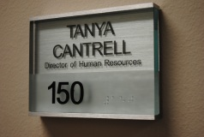
HUMAN RESOURCES
Department Description
Provides responsible leadership and direction in human resource services, including managing and administering recruiting, compensation, benefits, employee relations, training and records programs.
Monitors personnel polices and practices for compliance with local, state and federal laws that govern municipal employment practices.
Conducts and/or coordinates training and seminars for employee orientation, policies and procedures, performance management, safety and other programs that benefit the organization and employees.
Department Location
Human Resources is located in City Hall at 1311 Chestnut Street, Bastrop, Texas 78602.
Hours are 8:00 AM to 5:00 PM, Monday through Friday, excluding holidays.
You may contact the staff by phone at (512) 332-8800.
Expenditure Summary | FY 2012-2013 | FY 2013-2014 | FY 2013-2014 | FY 2014-2015
Classification | Prior YTD | Original Budget | Projected YTD | Budget
Personnel Services | 91,347 | 93,770 | 97,306 | 98,735
Supplies | 791 | 2,275 | 2,175 | 1,575
Maintenance | 0 | 1,500 | 1,100 | 0
Occupancy | 2,922 | 3,445 | 3,445 | 3,445
Contractual Services | 99 | 325 | 65 | 325
Other Charges | 13,129 | 13,685 | 13,920 | 15,685
Total | $108,288 | $115,000 | $118,011 | $119,765
82

Slide 83
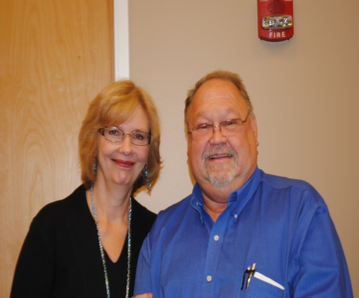
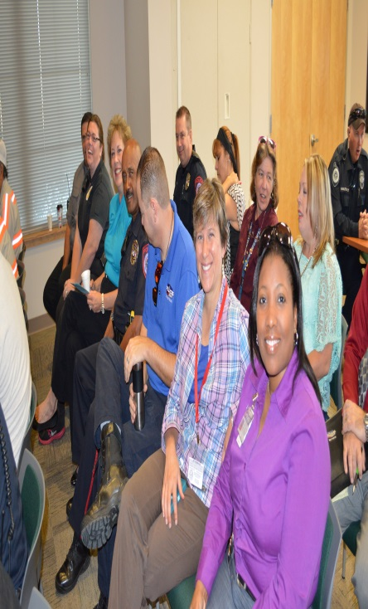
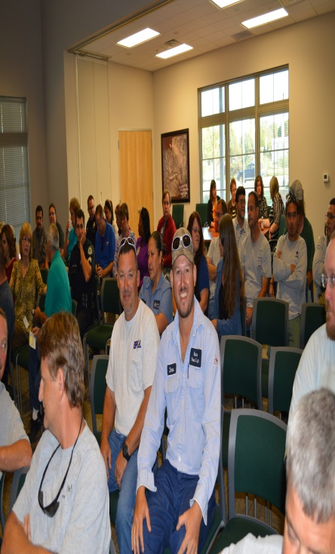

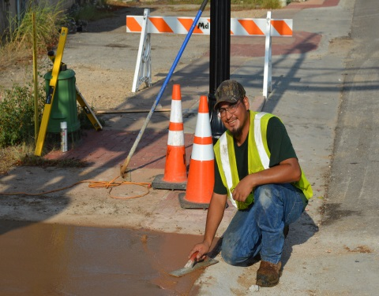
HUMAN RESOURCES continued
2013-2014 Accomplishments
Revised and updated job descriptions.
Revised and updated personnel compensation scale to reflect job description.
Continuation of new performance assessment and development form(s).
Reduce Worker’s Comp injuries through implementation of a City wide training program.
Implemented a variety of employee requests through the personnel committee.
2014-2015 Goals
Provide HR assistance to City Departments and applicants in an effective and timely manner.
Maintain Pay Plan integrity.
Update filing system in the HR Department.
Continue to reduce Worker’s Comp injuries/costs through training/mentor programs, working with TML.
Continue to improve employee morale/relations and retention program.
Strategic Planning for the organization as we move forward in this ever changing workforce.
Maintain and promote Employee Recognition Program.
Monitor and maintain personnel policies and practices for compliance with local, state and federal laws that govern municipal employment practices.
2014-2045 Budget Objectives
Continue to increase safety training program with TML to reduce Worker’s Comp. costs.

Slide 84
HUMAN RESOURCES continued
Performance Measurement Indicators | FY 2011-2012 | FY 2012-2013 | FY 2013-2014 | FY 2014-2015
Demand
City Population | 7,500 | 7,650 | 7,800 | 7,950
Number of Budgeted Positions Number of City Departments | 118.4 29 | 118.5 29 | 119.5 29 | 123.5 29
Input
Operating Expenditures | $104,925 | $107,660 | $118,011 | $119,765
Total Number of Personnel (FTE) | 1.1 | 1.1 | 1.1 | 1.1
Output
Number of Job Applications processed | 1,500 | 900 | 1,069 | 850
Number of Job Applicants Hired | 20 | 15 | 18 | 15
Number of Terminations processed | 12 | 15 | 20 | 10
Efficiency
HR Expenditures as % of General Fund | 1.28% | 1.27% | 1.29% | 1.21%
FTE as % of General Fund FTE | 1.24% | 1.24% | 1.24% | 1.21%
Effectiveness
% of Job Turnover Rate | 10% | 13% | 17% | 8%

Slide 85
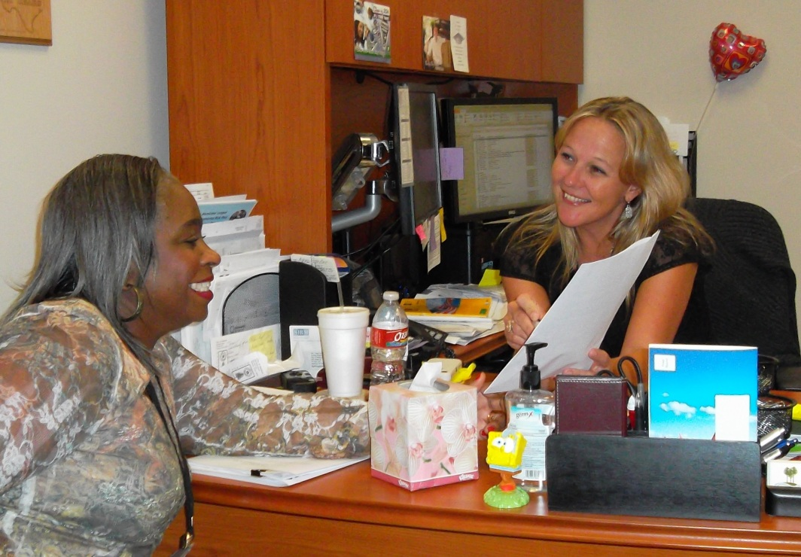
HUMAN RESOURCES continued
Staffing Summary | FY 2011-2012 | FY 2012-2013 | FY 2013-2014 | FY 2014-2015
Human Resources Director | 1.1 | 1.1 | 1.1 | 1.1
Total | 1.1 | 1.1 | 1.1 | 1.1
Human Resources
Director
Assistant
.1 FTE
HUMAN RESOURCES ORGANIZATIONAL CHART

Slide 86

INFORMATION TECHNOLOGY
Department Description
The Information Technology Department provides technical support to the organization for current software and equipment as well as planning for future technology initiatives.
Support includes assisting in the development and implementation of technology related policies and procedures.
Responsible for the implementation of technology as well as planning for future technology initiatives and vision. This includes design, development, and implementation of all voice, data, and video applications within the city.
Department Location
Information Technology is located in City Hall at 1311 Chestnut Street, Bastrop, Texas 78602.
Hours are 8:00 AM to 5:00 PM, Monday through Friday, excluding holidays.
You may contact the staff by phone at (512) 332-8800.
Expenditure Summary | FY 2012-2013 | FY 2013-2014 | FY 2013-2014 | FY 2014-2015
Classification | Prior YTD | Original Budget | Projected YTD | Budget
Personnel Services | 87,708 | 88,270 | 103,065 | 136,055
Supplies | 3,178 | 3,200 | 7,590 | 13,710
Maintenance | 20,101 | 21,000 | 22,000 | 85,270
Occupancy | 5,547 | 8,000 | 6,500 | 8,515
Contractual Services | 22,269 | 18,850 | 16,000 | 19,200
Other Charges | 2,849 | 3,900 | 3,000 | 4,200
Capital | 54,813 | 42,500 | 40,768 | 0
Total | $196,465 | $185,720 | $198,923 | $266,950
86

Slide 87
INFORMATION TECHNOLOGY continued
2013-2014 Accomplishments
Replacement of 20 desktop and laptop devices.
Implemented enhanced Wi-Fi access points at Library, Convention Center, and Main Street
• Released an enhanced secured VPN solution for the Police Department.
Upgraded City Internet from 3 Mbps to 30 Mbps.
Installed full function In-Car Video solution from WatchGuard for Police Department.
Installed 8 In-Car AT&T Routers for faster internet connection in Police Vehicles.
Implemented full redundant dual host server configuration at City Hall and Police Department.
Installed Laser fiche software for all City users.
2014-2015 Goals
• Creation/distribution of Technology Policies and Procedures and computer standards.
• Create a City intra-net website.
• Update Microsoft software to latest versions for servers, windows, and office.
• City wide data storage for all users and servers.
• Utilize Laser fiche for all departments to enhance retention and recall.
• Implement City wide replacement program for computers and servers.
• Reduce cell phone cost by migrating to pool plans.
2014-2015 Budget Objectives
Implement Generator Maintenance and service agreement.
• Upgrade Email Exchange server from 2003 to 2013.
• Upgrade Remote software to enhance security and reliability.
• Update enterprise software to latest versions.

Slide 88
INFORMATION TECHNOLOGY continued
Performance Measurement Indicators | FY 2011-2012 | FY 2012-2013 | FY 2013-2014 | FY 2014-2015
Demand
City Population | 7,500 | 7,650 | 7,800 | 7,950
Number of City Departments | 29 | 29 | 29 | 29
Number of Cell Phones | 69 | 89 | 86 | 85
Number of Desk Phones | 151 | 155 | 162 | 165
Number of Laptops | 19 | 25 | 28 | 30
Number of Desktops | 82 | 93 | 98 | 100
Number of Servers | 12 | 16 | 18 | 20
Total Manage Hard Disk Space | 4TB | 4TB | 5TB | 24TB
Number of Copiers Number of Printers Number of Network Equipment Number of Email Accounts | 9 38 19 110 | 10 42 25 115 | 12 48 48 175 | 15 50 50 180
Input
Operating Expenditures | $155,155 | $141,208 | $185,720 | 266,950
Total Number of Personnel (FTE) | 1 | 1 | 1 | 1.6
Efficiency
IT Expenditures as % of General Fund | 1.90% | 1.66% | 2.02% | 2.68%
FTE as % of General Fund FTE | 1.12% | 1.12% | 1.12% | 1.76%

Slide 89
Staffing Summary | FY 2011-2012 | FY 2012-2013 | FY 2013-2014 | FY 2014-2015
Information Technology Director | 1 | 1 | 1 | 1.625
Total | 1 | 1 | 1 | 1.625
INFORMATION TECHNOLOGY ORGANIZATIONAL CHART
Information Technology
Director

Slide 90

POLICE DEPARTMENT
Department Description
The Police Department is vested with the responsibility of protecting human lives, property, and improving the quality of life for visitors and citizens alike.
As a community service provider, the Department is responsible for routine residential, commercial, and highway patrols. Responding to calls for services regardless of the nature or severity of the incident.
The Police Department provides law enforcement and community policing services to the citizens of Bastrop twenty-four hours a day, 365 days of the year.
The Department conducts criminal investigations, motor vehicle accident investigations, traffic direction, crime prevention seminars, testifying in courts on behalf of the state, and the enforcement of local, state, and federal laws, including the Texas Transportation Code.
The Department also provides animal control services within the city limits. Code Enforcement, Emergency Management and Animal Control are divisions under the Police Department.
Department Location
Police Department is located in the Adell Powell Police and Courts Building at 104 Grady Tuck Lane, Bastrop, Texas 78602.
Hours are 8:00 AM to 5:00 PM, Monday through Friday, excluding holidays.
Administration and non-emergency phone (512) 332-8600.
For emergencies dial 911.
90

Slide 91

POLICE DEPARTMENT
Administration
Expenditure Summary Administration | FY 2012-2013 | FY 2013-2014 | FY 2013-2014 | FY 2014-2015
Classification | Prior YTD | Original Budget | Projected YTD | Budget
Personnel Services | 288,027 | 345,464 | 356,807 | 355,755
Supplies | 22,569 | 22,680 | 33,050 | 28,920
Maintenance | 22,861 | 28,070 | 27,967 | 25,141
Occupancy | 46,810 | 50,020 | 50,020 | 54,556
Contractual Services | 222,225 | 195,970 | 195,917 | 196,695
Other Charges | 30,185 | 33,185 | 31,335 | 32,735
Capital | 0 | 64,500 | 60,970 | 6,775
Total | $632,677 | $739,889 | $756,066 | $700,577
Code Enforcement
Expenditure Summary Code Enforcement | FY 2012-2013 | FY 2013-2014 | FY 2013-2014 | FY 2014-2015
Classification | Prior YTD | Original Budget | Projected YTD | Budget
Personnel Services | 47,302 | 48,056 | 49,321 | 49,170
Supplies | 1,227 | 3,000 | 1,700 | 1,100
Maintenance | 300 | 300 | 400 | 250
Occupancy | 0 | 0 | 0 | 0
Contractual Services | 855 | 900 | 850 | 20,700
Other Charges | 129 | 5,570 | 5,400 | 6,050
Total | $49,813 | $58,006 | $57,671 | $77,270

Slide 92



POLICE DEPARTMENT
Emergency Management
Expenditure Summary Emergency Management | FY 2012-2013 | FY 2013-2014 | FY 2013-2014 | FY 2014-2015
Classification | Prior YTD | Original Budget | Projected YTD | Budget
Supplies | 345 | 800 | 800 | 2,300
Maintenance | 0 | 2,500 | 2,500 | 2,500
Other Charges | 0 | 2,000 | 2,000 | 1,000
Capital | 0 | 0 | 0 | 0
Total | $345 | $5,300 | $5,300 | $5,800
Police CID
Expenditure Summary Police CID | FY 2012-2013 | FY 2013-2014 | FY 2013-2014 | FY 2014-2015
Classification | Prior YTD | Original Budget | Projected YTD | Budget
Personnel Services | 158,421 | 230,660 | 161,152 | 165,030
Supplies | 7,341 | 3,350 | 1,600 | 3,400
Maintenance | 214 | 1,460 | 1,160 | 1,460
Occupancy | 0 | 0 | 0 | 0
Contractual Services | 2,764 | 3,500 | 2,300 | 3,000
Other Charges | 3,098 | 6,120 | 4,420 | 4,745
Capital | 0 | 0 | 0 | 0
Total | $171,838 | $245,090 | $170,632 | $177,635
92

Slide 93
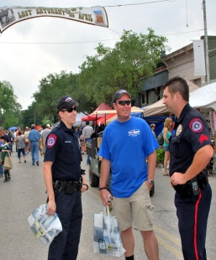


Police Patrol
Expenditure Summary Police Patrol | FY 2012-2013 | FY 2013-2014 | FY 2013-2014 | FY 2014-2015
Classification | Prior YTD | Original Budget | Projected YTD | Budget
Personnel Services | 1,069,593 | 1,093,470 | 1,103,547 | 1,284,305
Supplies | 59,315 | 68,140 | 68,140 | 105,013
Maintenance | 25,346 | 17,900 | 16,600 | 20,900
Occupancy | 0 | 0 | 0 | 0
Contractual Services | 9,344 | 12,000 | 12,000 | 16,310
Other Charges | 8,937 | 10,200 | 10,200 | 12,800
Capital | 31,558 | 115,000 | 115,000 | 169,500
Total | $1,204,094 | $1,316,710 | $1,325,487 | $1,608,828
Crime Prevention
Expenditure Summary Crime Prevention | FY 2012-2013 | FY 2013-2014 | FY 2013-2014 | FY 2014-2015
Classification | Prior YTD | Original Budget | Projected YTD | Budget
Personnel Services | 0 | 0 | 77,367 | 85,290
Supplies | 0 | 0 | 2,800 | 3,650
Maintenance | 0 | 0 | 300 | 2,000
Contractual Services | 0 | 0 | 600 | 1,500
Other Charges | 0 | 0 | 280 | 1,150
Total | $0 | $0 | $81,347 | $93,590

Slide 94

Animal Services
Expenditure Summary Animal Services | FY 2012-2013 | FY 2013-2014 | FY 2013-2014 | FY 2014-2015
Classification | Prior YTD | Original Budget | Projected YTD | Budget
Personnel Services | 28,352 | 39,130 | 42,810 | 0
Supplies | 2,399 | 7,450 | 7,450 | 7,255
Maintenance | 1,502 | 2,150 | 2,150 | 1,700
Occupancy | 0 | 0 | 0 | 0
Contractual Services | 2,100 | 2,175 | 1,425 | 2,175
Other Charges | 12,175 | 13,800 | 13,800 | 12,720
Total | $46,528 | $64,705 | $67,635 | $23,850

Slide 95
POLICE DEPARTMENT continued
2013-2014 Accomplishments
Conducted our second annual operation safe holiday.
Initiative with our animal control to register microchip, and vaccinate numerous animals in our community.
Create a neighborhood services officer for crime prevention programs.
Reduced intersection related crashes in excess of 5%.
Conducted neighborhood traffic surveys to establish trends and identify area to take enforcement action.
Enhanced the relationship between our SRO’s and the students by providing classroom programs.
Numerous officers have attended specialized training to better serve the public.
Provided training to our senior population in conjunction with the Sheriff’s Office.
2014-2015 Goals
A community free from crime and disorder remains an unachieved goal; as is consistent with values of a free society. The primary objective of the department is to, as closely as possible; attain that goal while recognizing both statutory and judicial limitations of police authority and the constitutional rights of all persons. The prime objective of the department is supplemented by the goals recognized both for itself and its members. These goals require every member of the department maintain the highest standards of integrity and ethics and assure excellence in the performance of duty while respecting the rights of every individual.
Significantly reduce the rate of theft and victimization of the people and business of Bastrop which accounts for over seventy percent of our UCR part one crime volume. This would include implementing specialized programs at our high crime rate areas.
2014-2015 Budget Objectives
Update the Police Department Policy Manual.
Increase patrol in high crime areas.
Implement a community survey to secure citizen feedback on the quality of police services being delivered.
Conducted neighborhood traffic surveys to establish trends and identify areas of enforcement.
Continue to increase police officer safety through specialized training.
Provide training on crime prevention topics tailored toward protecting our young population.
Create an accident reconstruction team for major accidents.
Increase patrol visibility on the TX 71 to reduce aggressive driving through our community.
Increase park patrol during peak times.

Slide 96
POLICE DEPARTMENT continued
Performance Measurement Indicators | FY 2011-2012 | FY 2012-2013 | FY 2013-2014 | FY 2014-2015
Demand
Service Population | 27,000 | 32,000 | 35,000 | 38,000
Calls for Service | 8,668 | 8,914 | 11,276 | 14,500
Index Crimes Reported | 487 | 421 | 554 | 600
Input
Operating Expenditures | $2,202,703 | $2,282,059 | $2,429,700 | $687,550
Total number of approved Officers | 20 | 20 | 20 | 21
Support Staff | 4.5 | 4.5 | 4.5 | 4.5
Output
Accident Investigations | 755 | 316 | 448 | 450
Citations Issued | 6,053 | 3,606 | 4,125 | 4,000
Total Arrest | 584 | 769 | 816 | 700
Part I Crimes Investigated | 487 | 421 | 554 | 600
Part II Crimes Investigated | 843 | 586 | 805 | 650
Efficiency
Overall Clearance Rate | 48% | 48% | 44% | 45%
Part 1 Crimes Clearance Rate | 29% | 42.7% | 36% | 35%
Part II Crimes Clearance Rate | 59% | 52.6% | 52% | 54%
Expenditures as % of General Fund | 26.93% | 26.8% | 26.5% | 23.5%
FTE as % of General Fund FTE | 20.7% | 20.6% | 20.5% | 28.1%
Effectiveness
Total Number of Cases Cleared | 640 | 489 | 598 | 680

Slide 97
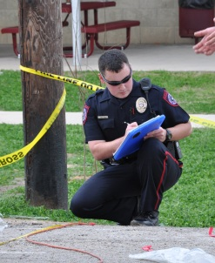
POLICE DEPARTMENT continued
POLICE DEPARTMENT continued
Staffing Summary | FY 2011-2012 | FY 2012-2013 | FY 2013-2014 | FY 2014-2015
CERTIFIED
Police Chief | 1 | 1 | 1 | 1
Assistant Police Chief | 1 | 1 | 1 | 1
Sergeant | 2 | 3 | 3 | 3
Corporal | 0 | 3 | 3 | 2
Detective | 3 | 2 | 2 | 2
Administrative Officer | 0 | 0 | 0 | 1
School Resource Officer | 3 | 2 | 2 | 1
Police Officer | 10 | 8 | 8 | 11
SUBTOTAL | 20 | 20 | 20 | 22
NON-CERTIFIED
Administrative Assistant | 1 | 1 | 1 | 1
Code Compliance Officer | 1 | 1 | 1 | 1
Records Technician | 1.5 | 1.5 | 1.5 | 0
Records Clerk | 0 | 0 | 0 | 1.5
File Clerk (part-time) | 0 | 0 | 0 | 0
Animal Control Officer | 1 | 1 | 1 | 0
SUBTOTAL | 4.5 | 4.5 | 4.5 | 3.5
TOTAL | 24.5 | 24.5 | 24.5 | 25.5

Slide 98
POLICE DEPARTMENT ORGANIZATIONAL CHART
Chief of Police
(1)
Administrative Assistant
(1)
Assistant Chief of Police
(1)
Operations (3)
Patrol (12)
Administration (6)
Police Chaplans
CID (2)

Slide 99
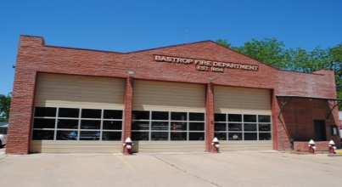
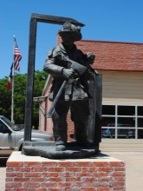
FIRE DEPARTMENT
Department Description
Responds to and extinguishes structure, vehicle, grass and brush fires in the City of Bastrop and surrounding fire district.
Responds to other emergency situations in conjunction with other emergency agencies.
Provides mutual aid to neighboring emergency agencies.
Conducts fire prevention activities and inspections.
Serves as primary water rescue team to the central part of the county.
Provides equipment and personnel to be available for local parades, festivals and sporting events.
Department Location
Fire Station 1 is located at 802 Chestnut Street, Fire Station 2 is located at 120 Corporate Drive, Fire Station 3 is located at 926 FM 1441 (Owned by Circle D Home Owners Association), and Fire Station 4 is located at 103 Indian Oak (Owned by Bastrop Fire Department Inc.)
For emergencies, call 911. For routine inquires, call (512) 332-8600.
Expenditure Summary | FY 2012-2013 | FY 2013-2014 | FY 2013-2014 | FY 2014-2015
Classification | Prior YTD | Original Budget | Projected YTD | Budget
Personnel Services | 5,706 | 15,000 | 15,000 | 5,000
Supplies | 54,698 | 56,725 | 57,914 | 59,075
Maintenance | 64,678 | 47,000 | 45,811 | 97,500
Occupancy | 35,259 | 43,650 | 43,650 | 46,650
Contractual Services | 23,027 | 24,000 | 24,000 | 31,040
Other Charges | 25,898 | 26,825 | 26,825 | 26,825
Total | $209,267 | $213,200 | $213,200 | $266,090
99

Slide 100
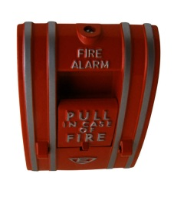

FIRE DEPARTMENT continued
2013-2014 Accomplishments
• Responded to 987 calls for service.
• Achieved a response time of 6.89 minutes.
• Provided Public Fire Education to 5200+ children.
• Provided in-house training to all firefighters.
• Twenty-three (23) firefighters attended 1,120 hours of training.
• All apparatus received 6-month preventative maintenance inspections and found no failures from lack of preventative maintenance.
• Provided planning review, inspection for C/O on all new commercial development.
2014-2015 Goals
• Provide excellent fire protection at acceptable cost.
• Control fire losses and reduce fire risk.
• Improve ISO rating classification.
• Update the 5-year master plan for the future of the Bastrop Fire Department.
• Present public fire education to persons of all ages within the fire service area.
• Incorporate the City of Bastrop into Bastrop County ESD #2.
2014-2015 Budget Objectives
• Strive to maintain total response time to calls of service to less than 5.5 minutes.
• All firefighters trained to SFFMA Introductory (Module 1) level training.
• Ten (10) firefighters trained to SFFMA Basic (Module 2) level Certification.
• Five (5) firefighters trained to SFFMA Intermediate (NFPA firefighter 1) level Certification.
• All apparatus will receive 6-month preventative maintenance inspections.
• Provide Public fire education to 5200+ children in the BISD and local day care facilities.

Slide 101
FIRE DEPARTMENT continued
Performance Measurement Indicators | FY 2011-2012 | FY 2012-2013 | FY 2013-2014 | FY 2014-2015
Demand
Incident Volume (emergency and non emergency) | 1,040 | 1,125 | 1,150 | 1,150
Input
Operating Expenditures | $203,505 | $190,445 | $213,200 | $266,090
Number of Personnel | 48 | 54 | 54 | 54
Volunteer Suppression | 40 | 46 | 46 | 46
Volunteer Administration | 8 | 8 | 8 | 8
Career Suppression | 0 | 3 | 3 | 3
Output
Priority Calls Answered | 325 | 398 | 450 | 475
Non-Emergency Calls Answered | 615 | 600 | 600 | 625
Efficiency
Coverage Population | 8,800 | 8,800 | 8,800 | 8,800
Fire Expenditures per Capita | $23.13 | $21.64 | $24.23 | $30.24
Expenditures as % of General Fund | 2.49% | 2.24% | 2.32% | 2.677%
Effectiveness
Response Time Average / City | 6.83 / 4.69 | 6.5 / 4.25 | 6.5 / 4.5 | 6.5 / 4.5
ISO Rating | 4 | 4 | 4 | 3

Slide 102
POLICE DEPARTMENT continued
FIRE DEPARTMENT continued
Staffing Summary | FY 2011-2012 | FY 2012-2013 | FY 2013-2014 | FY 2014-2015
ALL VOLUNTEERS
Chief | 1 | 1 | 1 | 1
Assistant Chief | 1 | 1 | 1 | 1
District Chief | 3 | 2 | 2 | 2
Captain | 4 | 4 | 4 | 4
Secretary | 1 | 1 | 1 | 1
Treasurer | 1 | 1 | 1 | 1
Chaplain | 1 | 1 | 1 | 1
Safety Officer | 2 | 2 | 2 | 2
Firefighters | 32 | 35 | 41 | 31
TOTAL | 46 | 48 | 54 | 44
FIRE DEPARTMENT ORGANIZATIONAL CHART
Fire Chief
(1)
Chaplain
(1)
Treasurer
(1)
Assistant
Fire Chief
(1)
Captain
(4)
Firefighters
(31)
Safety Officer (2)
Secretary(1)
District Chief
(2)

Slide 103

MUNICIPAL COURT
Department Description
The Municipal Court is an entry-level trial court in the Texas Judicial System.
The Municipal Court is the people’s court. The court processes between 2,000 and 4,000 cases a year; this means the Court see’s more people then any other court in the county.
The Municipal Court processes complaints filed by Bastrop Police Department, Citizens of the City, Bastrop Independent School District, and Officials of the City of Bastrop.
After adjudication, the Court is responsible to impose collection of all fines, maintain all records regarding court cases, prepare reports as required, to magistrate, set bonds, or fines, sign warrants for failure to comply with Court Orders, Failure to Appear, or Violation of Promise to Appear.
Issue warrants on A & B Misdemeanor and Felony Cases originating in the City of Bastrop.
Department Location
The Municipal Court is located in the Adell Powell Police and Courts Building at 104 Grady Tuck Lane, Bastrop, Texas.
Hours open to the public are 8:00 AM to 4:00 PM Monday through Friday, excluding holidays. Employee work hours are 8:00 AM to 5:00 PM.
You may contact staff by phone at (512) 332-8650 or (512) 581-0900.
Expenditure Summary | FY 2012-2013 | FY 2013-2014 | FY 2013-2014 | FY 2014-2015
Classification | Prior YTD | Original Budget | Projected YTD | Budget
Personnel Services | 275,751 | 289,720 | 297,331 | 295,960
Supplies | 11,005 | 10,500 | 9,550 | 10,000
Maintenance | 12,643 | 15,950 | 12,565 | 14,950
Occupancy | 9,065 | 10,310 | 10,310 | 10,310
Contractual Services | 21,804 | 27,850 | 23,350 | 27,850
Other Charges | 7,382 | 7,300 | 8,660 | 8,800
Capital | 0 | 0 | 0 | 0
Total | $337,651 | $361,630 | $361,766 | $367,870
103

Slide 104


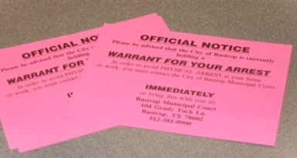
MUNICIPAL COURT continued
2013-2014 Accomplishments
• Court has maintained and processed an average of 275 tickets a month.
• Involved with the Greater Texas warrant roundup, clearing 96 warrants during the time of February 15th to the end of March. Processed 334 transactions and brought in $35,776 in revenue for the State and City.
• Implemented highly successful collections program consisting of telephone calls, warning letters, contact by Facebook and other social media sites, as well as warrant notification post cards.
• Implemented the new IVR system. We are successfully calling out automatic reminders to people for past due, warrants, Teen Court, pretrial, jury and other court notices as needed in mass form.
• Continued utilizing the Scofflaw which is another tool for collections by placing a hold on the vehicle for non-renewal of registration.
• We now have a Bailiff; we are utilizing him in the collection process whereby he calls past due or warrant defendants, when not in court.
Court staff continued their court education, with a Certified Court Manager and Certified Court Clerk, a Certified Level II Clerk, and a Certified Level I Clerk.
• One staff member represents the City of Bastrop on state board organizations, the Texas Municipal Courts Association and the Texas Municipal Clerks Association, and is also the President of the local municipal clerk’s chapter.
2014-2015 Goals
• Maintain accuracy and safety of records by updating data base systems and storage.
• Complete programs for collections, maintain efficient operations and expand community services.
• Continue to develop and expand the informational process for the citizens of the City and enhance community relations through webpage and other social media.
• Evaluate and develop a safer court environment.
• Purchase the second part of record management software to continue with the implementation of a paperless system.
• Evaluate and develop an effective and efficient manner of implementing court record management program and being more instrumental on staff time management and continued development of a paperless court.
• Purchase office equipment for employee’s use and to help interoffice morale.
2014-2015 Budget Objectives
• Implement software to complete record management and paperless court.
• To be able to work on customer service. Work on expanding the customer service window through a remodel of the lobby and court area.
Continue staff training to maintain knowledge of current laws and stay abreast of new technology available to the court.
• Continue implementation of Mediation Services for the court and a Peer Mediation Program through the Teen Court Program and collaborating with BISD on this years Shattered Dreams Program.

Slide 105
MUNICIPAL COURT continued
Performance Measurement Indicators | FY 2011-2012 | FY 2012-2013 | FY 2013-2014 | FY 2014-2015
Demand
Cases Filed | 2,006 | 1,990 | 2,012 | 2,000
Warrants Issued | 1,097 | 924 | 1,063 | 1,000
Magistrate/Jail Higher than Class C’s | 116 | 387 | 388 | 300
Juvenile Warnings and Statements | 5 | 11 | 12 | 10
Arrangements/Trials | 823 | 832 | 891 | 750
Input
Operating Expenditures | $350,355 | $353,973 | $370,950 | $367,870
Output
Collected Funds State and City | $373,654 | $345,880 | $367,372 | $292,500
Community Service/Jail Credit | $256,706 | $291,167 | $217,539 | $175,650
Efficiency
Cases Closed | 2,346 | 2,113 | 2,450 | 1,700
Cases sent to Omni | 1,677 | 1,263 | 943 | 1,000
Cases closed through Omni | 1,942 | 1,130 | 751 | 800
Warrants Cleared | 1,475 | 1,275 | 1,240 | 1,200
Teen Court | 80 | 51 | 75 | 50
MSB Collection cases sent | 0 | 451 | 508 | 600
Expenditures as % of General Fund | 5.19% | 4.18% | 4.07% | 3.70%
FTE as % of General Fund FTE | 6.17% | 6.17% | 6.17% | 6.06%
Effectiveness
Cases Appealed | 1 | 0 | 3 | 0
Deferred Adjudication Dismiss | 282 | 224 | 170 | 60
Driver’s Safety Dismiss | 207 | 38 | 76 | 140
Insurance Dismiss | 54 | 63 | 45 | 20
Compliance Dismissal | 44 | 31 | 46 | 20

Slide 106
POLICE DEPARTMENT continued
MUNICIPAL COURT continued
Staffing Summary | FY 2011-2012 | FY 2012-2013 | FY 2013-2014 | FY 2014-2015
Judge | 1 | 1 | 1 | 1
Municipal Court Administrator | 1 | 1 | 1 | 1
Court Clerk – Juvenile Case Manager | 1 | 1 | 1 | 1
Court Clerk – Customer Svc/Trial Coordinator | 1 | 1 | 1 | 1
Court Clerk - Collections | 1 | 1 | 1 | 1
Document Imaging Clerk (Part-time) | .5 | .5 | .5 | .5
Total | 5.5 | 5.5 | 5.5 | 5.5
MUNICIPAL COURT ORGANIZATIONAL CHART
Judge
Municipal Court Administrator
Municipal Court Clerk
(3)
Document Imaging Part-time Clerk – VOE Student

Slide 107
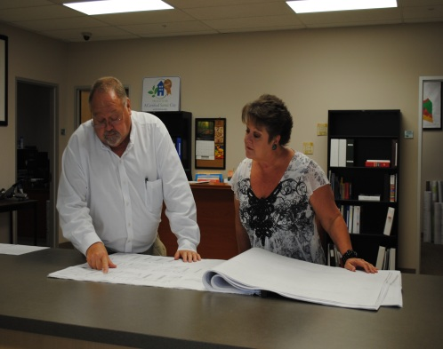
PLANNING AND DEVELOPMENT
Department Description
Planning is the process of identifying issues and needs, establishing goals and objectives, and determining the most effective means by which these ends may be achieved.
For community planning the process includes: maximize community strengths and minimize weaknesses; protect property rights and enhance property values; anticipate growth and provide adequate public facilities and services; balance economic growth with quality of life issues; and, avoid unmanageable concentrations or dispersal of population.
The Planning and Development Department is the professional staff that provides and facilitates the planning process and ensures the implementation of the plan through the development process.
The development process includes the enforcement of regulations on individual site construction to ensure compliance with the codes adopted by the City Council designed to achieve the goals and objectives of the plans.
Staff liaison to Planning and Zoning Commission (P&Z), Board of Adjustments (BOA), Historic Land Commission (HLC), Form Based Code Task Force, Impact Fee Advisory Committee, Municipal Sign Review Board and Construction Standard Board.
Department Location
Planning and Development is located in City Hall at 1311 Chestnut Street, Bastrop, Texas 78602.
Hours are 8:00 AM to 5:00PM, Monday through Friday, excluding holidays.
You may contact the staff by phone at (512) 332-8840.
Expenditure Summary | FY 2012-2013 | FY 2013-2014 | FY 2013-2014 | FY 2014-2015
Classification | Prior YTD | Original Budget | Projected YTD | Budget
Personnel Services | 348,298 | 435,470 | 451,300 | 457,590
Supplies | 15,114 | 16,270 | 15,200 | 13,850
Maintenance | 340 | 1,500 | 1,200 | 2,000
Occupancy | 7,983 | 11,810 | 11,810 | 12,700
Contractual Services | 133,549 | 137,150 | 137,200 | 357,350
Other Charges | 38,435 | 47,600 | 46,800 | 50,300
Capital Outlay | 0 | 0 | 6,500 | 0
Total | $543,719 | $656,800 | $670,010 | $893,790
107

Slide 108
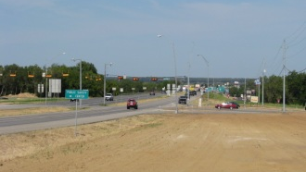
PLANNING AND DEVELOPMENT continued
2013-2014 Accomplishments
• Completed Fund/Draft Form Based Code for consideration/adoption.
• Continual improvement training of staff for GIS knowledge and efficiency.
• Updated Zoning and Annexation maps in house and online.
• Maintained and improved training for all boards and commissions that the Department supports.
• Work with Code Enforcement to complete a flyer for citizens
• Analyze design standards to be incorporated to the Zoning Ordinance.
• Continued to improve contractor permitting and inspection process.
• Continued to increase the utilization of GIS, WEB and other information technologies to make data and information readily usable by citizens, developers and staff.
• Completed 34 Pre-Development/Plan Review Meetings.
• Conducted 11 Preconstruction Meetings.
• Investigated and resolved 32 complaints related to zoning, subdivision and sign ordinances.
• Building permits resulted in an additional improvement value (excluding land value) of over $9 million building value to the City’s tax base.
2014-2015 Goals
• Adopt the Form Base Code for downtown
• Continue implementation of SDAT grant program guidelines and ideas.
• Continue Master Planning for Utilities and Capital Improvements
• Engineering Design and contract administration for in-house street and utility projects
• Update Construction Standards and Details
• Plan for future growth and Annexation Plan
• Update the Comprehensive Plan; complete the update to the Future Land Use Plan and CAMPO funded Thoroughfare Plan.
• Analyze online and electronic plan review and permitting.
• Continue to maintain and improve training for all boards and commissions that the Department supports.
• Continue to improve training of staff for GIS knowledge and efficiency.
• Continue to improve contract permitting and inspection process.
• Analyze design standards to be incorporated to the Zoning Ordinance.
• Analyze and prepare a professional fee ordinance to recapture increased development related costs.
• Continue to increase the utilization of GIS, WEB and other information technologies to make data and information readily usable by citizens, developers and staff.

Slide 109
PLANNING AND DEVELOPMENT continued
Performance Measurement Indicators | FY 2011-2012 | FY 2012-2013 | FY 2013-2014 | FY 2014-2015
Demand
Land within the City Limits | 7,021 AC | 8,500 AC | 8,500 AC | 8,500 AC
City Population | 7,500 | 7,650 | 7,800 | 7,950
Input
Operating Expenses | $465,539 | $543,719 | $670,010 | $893,790
Number of FTE Employees | 5 | 6 | 6 | 6
Output
Subdivision Cases Processed | 20 | 22 | 22 | 15
Subdivision revenues | $9,000 | $9,640 | $14,795 | $10,000
New Construction
Site Development Permits | 18 | 12 | 10 | 20
Site Development Fees | $14,200 | $9,600 | $8,650 | $16,000
Total Entitlement Cases | 58 | 40 | 32 | 50
Total Entitlement Revenues | $32,700 | $23,497 | $27,648 | $30,500
Efficiency
New Construction-Building Permits
Single Family | 59 | 22 | 72 | 50
Commercial | 8 | 17 | 11 | 22
Relocate/Demo | 14 | 15 | 19 | 15
Signs | 43 | 61 | 36 | 50
Other | 15 | 26 | 20 | 20
Total # of Permits | 139 | 141 | 158 | 157
Total Value | $15,305,041 | $16,984,537 | $21,690,642 | $17,500,000
Total new construction fees | $41,742 | $48,935 | $70,724 | $55,000
Remodeling and Additions
# of Commercial | 39 | 30 | 29 | 30
Commercial value | $4,739,713 | $2,486,505 | $3,375,512 | $3,000,000
Commercial fees | $11,901 | $11,079 | $8,251 | $12,000
# of Residential | 45 | 32 | 50 | 40
Residential value | $509,458 | $282,512 | $524,947 | $400,500
Residential fees | $2,543 | $2,570 | $3,058 | $3,000
Total value | $5,249,171 | $2,769,017 | $3,900,459 | $3,500,000

Slide 110
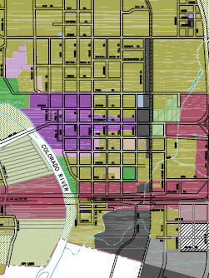
POLICE DEPARTMENT continued
PLANNING AND DEVELOPMENT continued
Staffing Summary | FY 2011-2012 | FY 2012-2013 | FY 2013-2014 | FY 2014-2015
Planning Director | 1 | 1 | 1 | 1
Project Coordinator | 1 | 1 | 1 | 1
Building Official | 1 | 1 | 1 | 1
Administrative Assistant | 1 | 1 | 1 | 1
Planning Technician | 1 | 1 | 1 | 1
City Engineer | 0 | 0 | 1 | 1
Total | 5 | 5 | 6 | 6
PLANNING AND DEVELOPMENT ORGANIZATIONAL CHART
Planning
Director
Building
Official
Project Coordinator
Planning Technician
Administrative Assistant
City Engineer

Slide 112

HEALTH
Department Description
To provide twenty-four (24) hour emergency ambulance service for the residents of the City of Bastrop.
Department Location
The City Manager and Chief Financial Officer oversee the programs established in the Health section of the operating budget.
The City Manager and Chief Financial Officer are located in City Hall at 1311 Chestnut Street, Bastrop, Texas 78602.
Hours are 8:00AM to 5:00 PM, Monday through Friday, excluding holidays.
You may contact the City Manager by phone at (512) 332-8800 or the Chief Financial Officer at (512) 332-8820.
Expenditure Summary | FY 2012-2013 | FY 2013-2014 | FY 2013-2014 | FY 2014-2015
Classification | Prior YTD | Original Budget | Projected YTD | Budget
Contractual Services | 71,026 | 71,050 | 47,351 | 0
Total | $71,026 | $71,050 | $47,351 | $0

Slide 113
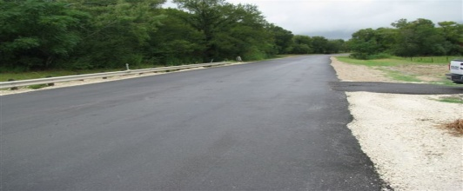
PUBLIC WORKS
Department Description
Maintains all City street surfaces (i.e., sweeping streets, crack sealing, resurfacing, tree trimming, pot- hole, utility cut repairs).
Maintain street signage (street names and traffic control signage)
Storm drainage, which is covered in two different categories: 1) underground storm sewer systems; 2) open gravity flow bar ditches.
Building maintenance and repair service for all City facilities.
Special events and other activities assistance, such as: Market Days, Yesterfest, Patriotic Festival, Movies in the Park, parades, Christmas / Holiday lighting, etc.
Construction of City facilities such as City parks, enhancements to City trails in the form of landscaping amenities and other improvements.
Maintain TxDOT ROW within the jurisdictional boundaries of the City.
Department Location
The Public Works Department facilities are located at 1209 Linden Street, Bastrop, Texas.
Office hours are 7:00 AM to 4:00 PM, Monday through Friday, excluding holidays.
You may contact staff by phone at (512) 332-8920 or (512) 332-8934.
Expenditure Summary | FY 2012-2013 | FY 2013-2014 | FY 2013-2014 | FY 2014-2015
Classification | Prior YTD | Original Budget | Projected YTD | Budget
Personnel Services | 607,298 | 594,700 | 665,911 | 637,740
Supplies | 68,558 | 81,500 | 82,420 | 82,500
Maintenance | 69,385 | 67,500 | 65,000 | 65,900
Occupancy | 14,328 | 14,010 | 14,010 | 14,010
Contractual Services | 27,378 | 34,050 | 33,550 | 35,925
Other Charges | 60,199 | 69,650 | 67,650 | 70,150
Capital | 65,494 | 67,000 | 68,680 | 155,000
Total | $912,640 | $928,410 | $997,221 | $1,061,225
113

Slide 114
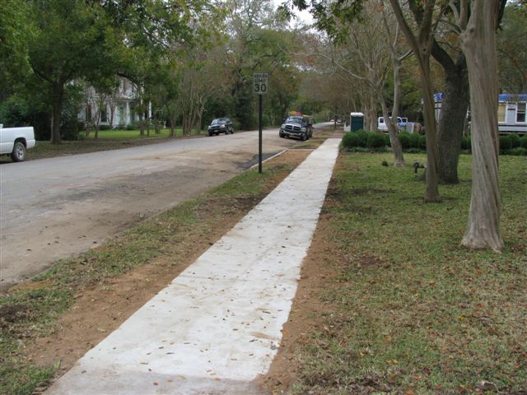
PUBLIC WORKS continued
2013-2014 Accomplishments
Completion of the Business Park, waterlines, streets and drainage improvements for Phase I
Completed Austin St., Oak St., Juniper St. & Persimmon St. improvements
Poured sidewalk on Chestnut St. at corner of Fayette across railroad tracks
Completed drainage work on Beech St., ran a storm sewer from Beech to Farm
Repaved Beech St. at Wilson St.
Reorganized all Public Works departments: Street and Drainage, Water Operation, Water Wastewater Field Division, Parks and Custodial.
Installed new flashing school zone signs throughout the City
Replaced all CARTS bus signs
2014-2015 Goals
Continue the high level of service to the community with existing resources.
Satisfy all customer complaints to the best of the department’s ability.
Respond in a reasonable time frame in regards to work orders.
Continue operating Transfer Station for the citizens of Bastrop.
Provide improved street and drainage services throughout the City.
Continue to provide support for special events as needed.
Provide employees with the proper equipment needed to increase departmental productivity.
Provide employees with continuing education and increased training to perform duties in a safe and responsible manner.
2014-2015 Budget Objectives
To work effectively using the existing resources available to the department.
Provide citizens with an increased level of efficiency resulting in lower cost and increased performance.
Improve streets and institute a street maintenance program to include a 50 year life on base material.
Improve drainage throughout town with the equipment purchased this fiscal year.

Slide 115
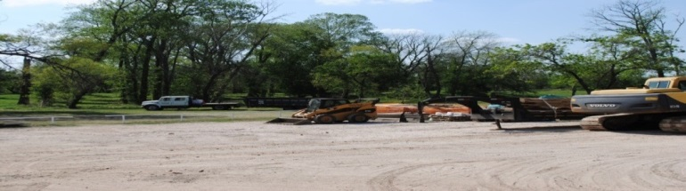
PUBLIC WORKS continued
Performance Measurement Indicators | FY 2011-2012 | FY 2012-2013 | FY 2013-2014 | FY 2014-2015
Demand
Miles of paved streets Miles of unpaved streets | 53 0 | 54 0 | 55 0 | 56 0
Number of street signs | 1425 | 1425 | 1425 | 1435
Miles of open drainage ditches | 50 | 50 | 50 | 50
Miles of storm sewer lines | 67 | 67 | 67 | 67
Input
Operating Expenditures | $912,460 | $928,410 | $997,221 | $1,061,225
Total number of employees in Public Works Department | 11 | 11 | 11 | 11
Output (Monthly Average)
Number of man hours utilized for street maintenance on a monthly basis | 155 | 200 | 200 | 200
Number of man hours utilized for work orders on a monthly basis | 25 | 23 | 40 | 40
Number of man hours utilized for street reconstruction / improvements on a monthly basis | 200 | 225 | 400 | 400
Street Sign Replacement Program on a monthly basis | 25 | 26 | 40 | 40
Number of man hours utilized for special projects on a monthly basis | 75 | 75 | 75 | 75
Number of man hours utilized for special events on a monthly basis | 55 | 56 | 55 | 55
Efficiency
Work order response time (in hrs) | 80 | 48 | 48 | 48

Slide 116
POLICE DEPARTMENT continued
PUBLIC WORKS continued
Staffing Summary | FY 2011-2012 | FY 2012-2013 | FY 2013-2014 | FY 2014-2015
Public Works Director | .5 | .5 | .5 | .5
Street & Drainage Foreman | 1 | 1 | 1 | 1
Mechanic | 1 | 1 | 1 | 1
Crew Leader | 0 | 0 | 1 | 1
Equipment Operator II | 7 | 6 | 2 | 2
Equipment Operator I | 0 | 0 | 3 | 3
Maintenance Worker II | 1 | 2 | 1 | 1
Maintenance Worker I | 0 | 0 | 1 | 1
Administrative Assistant | .5 | .5 | .5 | .5
TOTAL | 11 | 11 | 11 | 11
Public Works Director
(.5)
Administrative Assistant
(.5)
Street & Drainage Foreman
(1)
Mechanic
(1)
Crew Leader
(1)
Equipment Operator II
(2)
Equipment Operator I
(3)
Maintenance Worker II
(1)
Maintenance Worker 1
(1)
PUBLIC WORKS ORGANIZATIONAL CHART

Slide 117


RECREATION
Department Description
The Recreation Department includes funding for the YMCA in addition to other recreational activities approved by City Council.
YMCA - To assemble an advisory committee of eight community members to guide and support the direction of programs and services in youth development, healthy living and social responsibility for youth, adults and families.
Department Location
The Recreation Coordinator is located in City Hall at 1311 Chestnut Street, Bastrop, Texas 78602.
Office hours are 8:00 AM to 5:00 PM, Monday through Friday, excluding holidays.
You may contact staff by phone at (512) 332-8805.
Expenditure Summary | FY 2012-2013 | FY 2013-2014 | FY 2013-2014 | FY 2014-2015
Classification | Prior YTD | Original Budget | Projected YTD | Budget
Personnel Services | 0 | 0 | 0 | 0
Supplies | 0 | 0 | 0 | 0
Maintenance | 0 | 0 | 0 | 0
Occupancy | 0 | 0 | 0 | 0
Contractual Services | 39,500 | 39,500 | 39,500 | 42,500
Other Charges | 0 | 0 | 0 | 0
Total | $39,500 | $39,500 | $39,500 | $42,500
Goals for the YMCA of Austin in Bastrop area
To research the need for recreational programs and services in the Bastrop area.
117

Slide 118
RECREATION continued
RECREATION ORGANIZATIONAL CHART
Recreation Coordinator*
* Recreation Coordinator position funded through YMCA / BEDC.

Slide 119
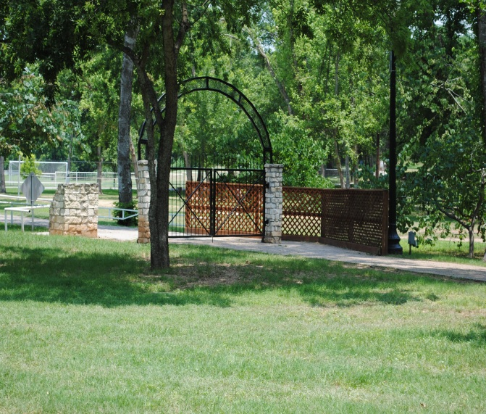
PARKS DEPARTMENT
Department Description
The Parks Department is responsible for maintaining all City parks, playgrounds, picnic areas, restroom facilities, and hike and bike trails within the City limits.
The crew mows and maintains all street right-of-ways, city facilities, and ensures that downtown sidewalks and hike and bike trails remain clean.
As part of their downtown maintenance routine, the department provides a trash pickup service three times weekly which includes the major thoroughfares of the TxDOT right-of-way on Chestnut Street and other locations as needed.
The department provides trash pick up services and routine maintenance to Bastrop’s Industrial Park, Farmers Market, and Fairview Cemetery on a weekly basis.
Department Location
The Parks Department facilities are located at 1209 Linden Street, Bastrop, Texas.
Office hours are 7:00 AM to 4:00 PM, Monday through Friday, excluding holidays.
You may contact staff by phone at (512) 332-8920 or (512) 332-8922.
Expenditure Summary | FY 2012-2013 | FY 2013-2014 | FY 2013-2014 | FY 2014-2015
Classification | Prior YTD | Original Budget | Projected YTD | Budget
Personnel Services | 484,282 | 522,810 | 556,457 | 529,820
Supplies | 53,466 | 41,370 | 43,775 | 42,370
Maintenance | 41,771 | 42,550 | 45,049 | 44,700
Occupancy | 63,172 | 62,740 | 63,650 | 62,740
Contractual Services | 10,113 | 12,880 | 7,800 | 21,380
Other Charges | 3,903 | 6,550 | 9,000 | 6,550
Capital | 11,500 | 16,000 | 16,000 | 33,000
Total | $668,207 | $704,900 | $741,731 | $740,560
119

Slide 120
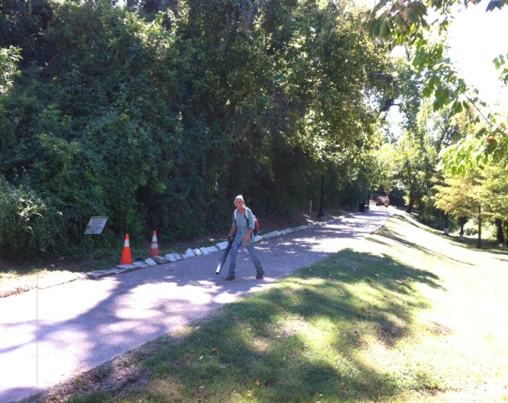
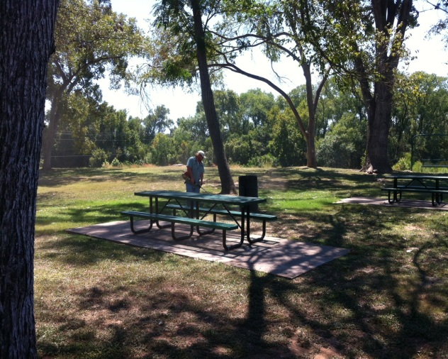
PARKS DEPARTMENT continued
2012-2013 Accomplishments
2013-2014 Accomplishments
Improved on erosion control along the river at Fisherman’s Park.
Completed Bridge inspection.
Evaluated a more efficient way for our crews to travel to and from the parks.
Added a Parks Crew leader to help build depth in the department structure.
Began mowing all city facilities including all water/wastewater plants and lift stations.
Continued to improve on all City parks through grants and the assistance of the Parks Board.
Found a location for the Skate Park and had it approved by Council.
2014-2015 Goals
To maintain parks and facilities at a level that ensures a clean, safe, enjoyable environment.
Increase department safety and start a city wide Safety Committee.
Ensure that all city facilities, grounds, and right-of-ways are maintained and attractive.
Provide quality and timely service in a professional manner to customers of the City.
Continue to provide recreational activities in the parks and support to special events.
To continue to project a professional and caring attitude when dealing with the public.
2014-2015 Budget Objectives
Provide more amenities to the Park system.
Update the master Parks plan.
Increase Park land and add a disk golf course.
Start design on Bastrop Skate Park.

Slide 121
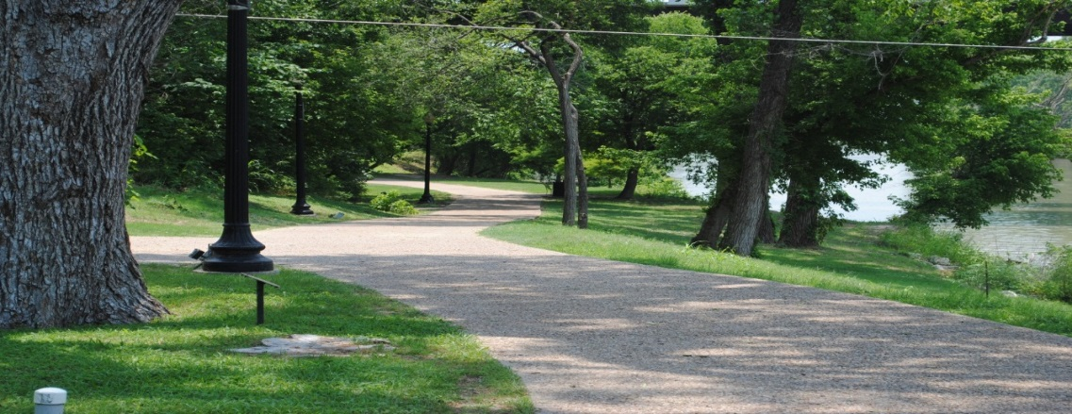
PARKS DEPARTMENT continued
Performance Measurement Indicators | FY 2011-2012 | FY 2012-2013 | FY 2013-2014 | FY 2014-2015
Demand
Parks | 9 | 9 | 9 | 9
Retention Pond | 3 | 5 | 5 | 5
Right of Ways | 55 | 55 | 55 | 55
Buildings | 9 | 10 | 10 | 10
Park Acres maintained | 120 | 120 | 120 | 120
Sprinkler Systems | 9 | 10 | 10 | 10
Tennis Court | 2 | 2 | 2 | 2
Basketball Court | 4 | 4 | 4 | 4
Special Events | 23 | 24 | 56 | 56
River walk | 1 | 1 | 1 | 1
Ball Fields | 7 | 7 | 7 | 7
Hike & Bike Trails | 3 | 4 | 4 | 4
Playscapes | 4 | 4 | 4 | 4
Input
Parks Expenditures | $724,077 | $669,877 | $704,900 | $740,560
Parks Staff Employees | 12.6 | 12.6 | 12.6 | 11
Volunteer Hours-Clean Sweep | 40 | 0 | 0 | 0
Output
Special Events | 23 | 24 | 56 | 56
Recreation Program Participants | 25 | 400 | 400 | 400
Pavilion Rentals | 95 | 96 | 96 | 96
New Trees Planted | 75 | 50 | 50 | 50

Slide 122
POLICE DEPARTMENT continued
PARKS DEPARTMENT continued
Staffing Summary | FY 2011-2012 | FY 2012-2013 | FY 2013-2014 | FY 2014-2015
Director of Public Works | .40 | .50 | .50 | .50
Parks Superintendent | 0 | 0 | 0 | 0
Recreation Coordinator | 0 | 0 | 0 | 0
Parks Foreman | 1 | 1 | 1 | 1
Administrative Assistant | .40 | .50 | .50 | .50
Parks Crewleader | 0 | 0 | 1 | 1
Parks Maintenance Specialist | 0 | 1 | 1 | 1
Maintenance Worker II | 9 | 8 | 7 | 7
Seasonal Maintenance Worker II | .20 | .20 | .20 | .20
TOTAL | 11.0 | 11.0 | 11.0 | 11.0
PARKS ORGANIZATIONAL CHART
Public Works Director
Administrative
Assistant
Parks Foreman
Maintenance Worker II
(7)
Parks Maintenance Specialist
(1)
Parks Crewleader
(1)

Slide 123

BUILDING MAINTENANCE
Department Description
The department consists of four full time employees with the responsibility of cleaning all City facilities.
In addition to cleaning, employees are responsible for stocking restroom supplies and performing light maintenance such as replacing light bulbs and cleaning air conditioning filters.
On an as needed basis, these employees are responsible for setting up meeting rooms at the Library, City Hall and the Police Department.
Department Location
The supervisor for the custodial staff is located at 1209 Linden Street, Bastrop, Texas 78602.
Office hours are 7:00 AM to 4:00 PM, Monday through Friday, excluding holidays.
You may contact staff by phone at (512) 332-8920.
Expenditure Summary | FY 2012-2013 | FY 2013-2014 | FY 2013-2014 | FY 2014-2015
Classification | Prior YTD | Original Budget | Projected YTD | Budget
Personnel Services | 152,421 | 154,228 | 158,353 | 158,920
Supplies | 3,053 | 9,100 | 8,100 | 10,100
Maintenance | 2,866 | 3,600 | 3,500 | 3,500
Occupancy | 316 | 472 | 420 | 1,200
Contractual Services | 1,809 | 1,690 | 1,690 | 2,090
Other Charges | 0 | 110 | 110 | 0
Total | $160,466 | $169,200 | $172,173 | 175,810
123

Slide 124

BUILDING MAINTENANCE continued
2013-2014 Accomplishments
The custodial schedule was changed to utilize personnel more effectively with all custodians assigned responsibilities at all facilities.
2014-2015 Goals
Continue to provide quality janitorial services to all City facilities.
Ensure City employees have a clean, safe, and pleasant office environment to work in.
Increase our productivity as well as expanding the service to a much more detailed cleaning routine rather than just hitting the worst areas and consistently falling behind on other areas.
Provide a better building maintenance service to make sure our office personnel have a professional and comfortable atmosphere to work in.
2014-2015 Budget Objectives
Maintain current services without a significant increase in funds.
Find resources for quality products at a reduced cost to the City.
Work with current vendors to qualify for bulk purchases for additional discounts and savings.
Ensure we have adequate personnel to carry out operations to the best of our abilities.
124

Slide 125
BUILDING MAINTENANCE continued
Performance Measurement Indicators | FY 2011-2012 | FY 2012-2013 | FY 2013-2014 | FY 2014-2015
Demand
City Facilities-Square Footage
City Hall | 12,000 | 12,000 | 12,000 | 12,000
Water/Wastewater | 1,500 | 1,500 | 1,500 | 1,500
Public Works | 1,700 | 1,700 | 1,700 | 1,700
Library | 19,000 | 19,000 | 19,000 | 19,000
Fire Station (2) | 2,270 | 2,270 | 2,270 | 2,270
Water Office | 1,690 | 1,690 | 1,690 | 1,690
Police Station | 12,560 | 12,560 | 12,560 | 12,560
Convention Center | 26,000 | 26,000 | 26,000 | 26,000
Total | 76,720 | 76,720 | 76,720 | 76,720
Input
Operating Expenditures | $164,590 | $167,852 | $169,200 | $175,810
Number of FTE | 4 | 4 | 4 | 4
Output
City Facilities - Hrs. Per Month
City Hall | 148 | 148 | 148 | 148
Water/Wastewater | 60 | 60 | 60 | 60
Public Works | 50 | 50 | 50 | 50
Library | 148 | 148 | 148 | 148
Fire Station (2) | 20 | 20 | 20 | 20
Utilities Office | 0 | 0 | 0 | 0
Police Station | 110 | 110 | 110 | 110
Convention Center | 120 | 120 | 120 | 120
Total | 656 | 656 | 656 | 656
Efficiency
Hours per FTE per month | 164 | 164 | 164 | 164
Effectiveness
Cost per square foot of maintenance per year | $2.15 | $2.19 | $2.19 | $2.19

Slide 126
POLICE DEPARTMENT continued
BUILDING MAINTENANCE continued
Staffing Summary | FY 2011-2012 | FY 2012-2013 | FY 2013-2014 | FY 2014-2015
Custodian | 4 | 4 | 4 | 4
TOTAL | 4 | 4 | 4 | 4
Public Works Director
(1)
Custodian (4)
Parks Foreman (1)
BUILDING MAINTENANCE ORGANIZATIONAL CHART

Slide 127


BASTROP PUBLIC LIBRARY
Department Description
Collects, classifies, organizes and makes available information in all formats for the community.
Encourages reading by providing materials and enrichment programs for patrons of all ages.
Develops and maintains collections of print , non-print and digital materials for patrons of all ages.
Provides a regular preschool story time, monthly programs for teens and summer reading programs for children, teens and adults.
Provides public access computers in the Children, Teen, Adult, and WIFI areas of the library.
Responds to telephone, on-site information and readers advisory requests.
Provides meeting room areas for the general public, clubs and nonprofit corporations.
Provides local history and genealogical resources.
Provides access via the internet to the TexShare databases in order to support the communities need for formal education, independent learning and business development.
Department Location
The Library is located at 1100 Church Street, Bastrop, Texas 78602.
Hours are Monday, Wednesday and Friday from 10:00 AM to 6:00 PM, Tuesday and Thursday from 1:00 PM to 9:00 PM, Saturday from 10:00 AM to 4:00 PM, closed on Sunday.
You may contact library staff at (512) 332-8880. Fax number (512) 332-8899.
Web address www.bastroplibrary.org Email Mickey@bastroplibrary.org
Expenditure Summary | FY 2012-2013 | FY 2013-2014 | FY 2013-2014 | FY 2014-2015
Classification | Prior YTD | Original Budget | Projected YTD | Budget
Personnel Services | 480,796 | 508,650 | 525,752 | 504,783
Supplies | 53,232 | 72,105 | 65,499 | 64,685
Maintenance | 9,288 | 11,000 | 16,653 | 13,350
Occupancy | 30,626 | 37,380 | 37,380 | 41,389
Contractual Services | 20,333 | 19,920 | 18,919 | 19,125
Other Charges | 11,035 | 12,135 | 12,768 | 11,948
Capital | 0 | 0 | 0 | 0
Total | $605,309 | $661,190 | $676,971 | $655,280

Slide 128

BASTROP PUBLIC LIBRARY continued
2013-2014 Accomplishments
Children's librarian provided tours to 741 Bastrop ISD students, participated in Literacy Night and Science Night activities at various BISD Elementary Schools.
Organized participants in the BISD Back to School Bash, National Night Out, Downtown Business Alliance Halloween Fest, and Downtown Alliance Veterans’ Day Car Show to increase public awareness of the library as part of a library marketing plan.
Applied and received the Ladd and Katherine Hancher Library Grant for early literacy outreach.
Coordinated annual Bookmark Contest to celebrate National Library week. All BISD elementary schools and the Bastrop Co. Homeschoolers participated and created 1,982 bookmarks.
Restructured the monthly Homeschool class to include students ages 7-14 and to encourage recreational reading as well as library skills for an average of 18 homeschoolers each month.
Planned, coordinated and implemented Summer Reading Program. Registered 1,146 participants including 734 children, 112 teens and 300 adults
Offered monthly family Super Saturday programs, Lego Club, Bow Wow Book Buddies with therapy dog Luke, after school story time for Calvary Episcopal School and weekly story time plus activity time which promotes social interaction and early learning activities.
Staff began providing weekly free computer classes as a continuation of the BTOP Technology Grant that ended Dec 2013.
The University of North Texas continues digitizing older copies of the Bastrop Advertiser for their Portal of Texas History database and website. Total of 76,312 searches performed on website.
Library received $15,300 donation from Friends of the Library to underwrite funds needed to pay for library programming.
Library has 3,155 volunteer hours
Lighting fixtures in the original part of the building were retrofitted to improve lighting.
Library applied for and received a $10,000 Texas State Library Impact Grant. The grant funds were used to purchase new ebooks and ebook readers.
Library purchased new shelving for the Teen room.
Library is working with the Federal prison to provide books for inmates.
Provided teen programs three times a month with an attendance of 609 teens.
Add an estimated 1,800 items per year from donations (averages about 3% of collection).
2014-2015 Goals
After the Hancher Grant ends, extend current outreach services by presenting story times and promote use of BEAR story time boxes at local day care centers.
Increase promotion of Ready to Read literacy materials at Head Start and child care centers.
Increase number of programs offered for tween population and adults.
Increase participation in after school activities by offering more programs.
Initiate increased cooperation with BISD by offering librarian visits to classrooms & afterschool
Participate in festivals and other events to publicize the library to the greater community.
Continue to work on the Bastrop County Complex Wildfire Archive.
2014-2015 Budget Objectives
Increase number of programs and participants at programs.
Continue efforts in staff development and training.
Continue upkeep of Library's grounds and facilities.
Increase one three quarter part-time employee to full time
Increase the number of digital books, audiobooks, & DVD/CD audiobooks in our collection.
Replace circulation and staff computers.

Slide 129
BASTROP PUBLIC LIBRARY continued
Performance Measurement Indicators | FY 2011-2012 | FY 2012-2013 | FY 2013-2014 | FY 2014-2015
Demand
Card Holders Added: | 2,342 | 2,396 | 2,130 | 2,130
City-Juvenile and adult | 559 | 504 | 470 | 470
County-Juvenile and adult | 1,783 | 1,892 | 1,660 | 1,660
Collection:
Cataloged Items | 50,504 | 50,157 | 50,765 | 50,800
Un-cataloged Items | 2,000 | 2,000 | 2,000 | 2,000
Magazine subscriptions | 90 | 90 | 90 | 90
Services::
Total Circulation | 163,577 | 165,667 | 167,324 | 168,997
Reference requests | 15,382 | 16,206 | 19,844 | 20,000
Story Time & program attendance | 12,562 | 13,161 | 13,500 | 13,500
Summer Reading Program | 1,143 | 1,146 | 1,150 | 1,150
Interlibrary loan requests | 413 | 592 | 546 | 546
User Population (per TX State Lib.) Computer Use | 7,306 33,056 | 7,306 37,626 | 7,306 33,502 | 7,306 33,502
Input
General Fund Operating expenditures | $624,093 | $623,940 | $661,190 | $655,280
Output
Number of library visits | 116,898 | 110,164 | 110,000 | 110,000
Volunteer hours per month | 314 | 263 | 270 | 270
Library fines and fees | $17,000 | $17,000 | $17,000 | $17,000
Donations/Grants | $55,935 | $46,119 | $18,500 | $18,500
Effectiveness
% Increase in circulation | -15% | 1.01% | 1.01% | 1.01%
# of books checked out per capita | 22.39 | 22.68 | 22.9 | 22.95
Library materials per capita | 6.91 | 6.87 | 7.22 | 7.17
Circulation per paid staff member | 16,777 | 16,993 | 17,161 | 17,333
Circulation per library visit | 1.40 | 1.50 | 1.52 | 1.54
Collection turn-over rate | 3.25 | 3.30 | 3.30 | 3.33
Computer user per capita Computer Use per Library Visit | 4.52 3.54 | 5.15 2.93 | 4.59 3.28 | 4.55 3.28

Slide 130
POLICE DEPARTMENT continued
BASTROP PUBLIC LIBRARY continued
Staffing Summary | FY 2011-2012 | FY 2012-2013 | FY 2013-2014 | FY 2014-2015
Library Director | 1 | 1 | 1 | 1
Assistant Library Director | 1 | 1 | 0 | 0
Librarian – Reference & Young Adult | 0 | 0 | 1 | 1
Librarian – Children’s Services | 1 | 1 | 0 | 0
Library Associate Supervisor | 1 | 1 | 0 | 0
Library Supervisor - Technical Svcs./ Circulation | 0 | 0 | 1 | 1
Library Supervisor- Public Svcs./ Programs | 0 | 0 | 1 | 1
Library Associate/Web-Graphic Dev | 1 | 1 | 1 | 1
Library Associate (40 hrs) | 1 | 1 | 1 | 1
Library Associate (32 hrs) | .8 | .8 | .8 | .8
Library Assistant (40 hrs) | 2 | 2 | 2 | 2
V.O.E. Office Assistant (20 hrs) | 1 | 1 | 1 | 1
Total | 9.8 | 9.8 | 9.8 | 9.8
Library Director
Library Supervisor –Tech. Svcs ./Circ.
Library Associate
Web Graphic Development
Library
Associate 40 hrs. (1)
Library
Associate 32 hrs. (.8)
VOE Office
Assistant (1)
Young Adult Librarian
Library Supervisor- Pub. Svcs/ Pgms
BASTROP PUBLIC LIBRARY ORGANIZATIONAL CHART

Slide 131
Proprietary Funds

Slide 133
WATER/ WASTEWATER FUND
The City’s water and wastewater utilities are financed and operated in a manner
similar to private business enterprises, where costs of providing services to the
public are financed primarily through user charges.
Divisions included within the Water/ Wastewater Department include:
Water/ Wastewater Administration,
Water/ Wastewater Distribution, Collection, and Lift Station
Water/ Wastewater Production Treatment
Wastewater Treatment Plant

Slide 134
WATER/ WASTEWATER FUND-OPERATING
COMBINED STATEMENT OF REVENUES AND EXPENSES
 |  | ACTUAL | BUDGET | ESTIMATE | BUDGET
 |  | 2012-2013 | 2013-2014 | 2013-2014 | 2014-2015
BEGINNING BALANCE |  | $ 1,289,172 | $ 1,831,353 | $ 1,916,338 | $ 1,941,458
REVENUES:
 | Water Service | 2,038,620 | 2,239,920 | 2,150,000 | 2,296,400
 | Sewer Service | 1,294,559 | 1,433,550 | 1,393,000 | 1,487,820
 | Penalties | 51,333 | 49,000 | 50,000 | 50,000
 | Water Tap Fees | 900 | 1,000 | 8,000 | 1,000
 | Sewer Tap Fees | 1,200 | 1,000 | 1,000 | 1,000
 | Water Service Fees | 29,041 | 26,000 | 26,000 | 26,000
 | Septic Tank Dump Fees | 109,283 | 100,000 | 100,000 | 100,000
 | Other | 528,356 | 84,500 | 86,010 | 88,200
 | TOTAL REVENUES | 4,053,291 | 3,934,970 | 3,814,010 | 4,050,420
EXPENDITURES:
 | Administration | 2,167,008 | 2,566,980 | 2,564,350 | 2,431,574
 | Distribution/ Collection/ Liftstation | 355,506 | 225,150 | 213,350 | 205,300
 | Production/ Treatment | 385,480 | 280,800 | 270,300 | 311,850
 | Wastewater Treatment Plant | 238,417 | 379,410 | 383,300 | 277,900
 | TOTAL EXPENDITURES | 3,146,411 | 3,452,340 | 3,431,300 | 3,226,624
NET INCOME (LOSS) |  | 906,881 | 482,630 | 382,710 | 823,796
ENDING FUND BALANCE |  | $ 2,196,053 | $ 2,313,983 | $ 2,299,048 | $ 2,765,254
 | Designated Accounts:
 | Water Stabilization | $ (167,070) |  | $ (210,720) | $ (223,363)
 | Wastewater Stabilization | $ (112,645) |  | $ (146,870) | $ (155,682)
 | Operating Ending Fund Balance | $ 1,916,338 |  | $ 1,941,458 | $ 2,386,208

Slide 135
Water/ Wastewater Fund Expenditures
FY 2014-2015
$ 3,226,624
Water / Wastewater Fund Revenues
FY 2014-2015
$ 4,050,420

Slide 136
WATER WASTEWATER
Administration:
Work with City Council and staff to maintain current levels of acceptable services to customers and improve levels of services where needed.
Ensure annual review of water and wastewater impact fees, capital improvements program and water distribution improvement program.
Comply with state regulations and reporting requirements including monthly operational reports, consumer confidence reports, backflow prevention and drought contingency planning.
Calculate water taps, wastewater collection taps and water and wastewater impact fees for new development.
Support/cooperate with Lost Pines Groundwater Conservation District.
Provide customers with a high quality drinking water while being cost effective and efficient.
Support and participate in the Water Conservation Program.
Provide water services relating to the processing and distribution of the City’s water supply.
Upgrade wastewater mapping system.
Ensure wastewater operation and maintenance practices are in accordance with Federal/State regulations including compiling daily data for Monthly Discharge Permit report, and Biomonitoring the discharge and the river; measure toxicity from biosolids production.
Treat wastewater to the best quality achievable while using cost efficient practices and providing customer’s all the services associated with the operation and maintenance of a safe, dependable, and affordable wastewater treatment and pollution control system.
Provide assistance and data to possible new developers in the community.
Receive, prepare/process work orders and line locate requests from customers and excavators.
Oversee septic hauler discharges to reception location, including manifests and city charge invoices.
Maintain Department web page, create and distribute informational and educational materials, and create and maintain complex filing system and departmental data.
Water Production/ Treatment in Two (2) Facilities (Willow’s Plant and Bob Bryant Plant):
Operate, monitor and maintain 5 wells at Fisher Man’s Park and 2 wells at Bob Bryant Park.
Comply with TCEQ regulations in the operation and maintenance of the system.
Adjust water treatment operation based on system demand.
Perform daily testing of water for chlorine to ensure proper disinfection. Regulate feed rates of treatment process. Maintain logs/records of treatment performance. Collect bacteriological samples from distribution system. Treat raw water for Manganese, Lead and Copper. Add fluoride to the water on the advice of local dentists.
Maintain 3 chlorine auto analyzers including chemicals and chart recorders.
Pump potable water throughout the city, averaging above 1.306 million gallons per day.
Provide operation of treatment plant 24-hours per day, 7-days per week.
Operate a system that provides water to 3 separate pressure zones.
Maintain and repair 8 high service pumps and 2 transfer pumps; 6 Variable Frequency Drives; 6 water storage tanks with total capacity of 2,715,000 gallons; 9 pressure reducer, 2 altitude valves, multiple solenoid valves, and 2 chlorine booster systems.
Water Distribution, Wastewater Collection, Wastewater Lift Stations:
Monitor/maintain 500 fire hydrants, wastewater lines, and 18 lift stations throughout the city.
Perform over 240 routine flushing operations in distribution system to maintain chlorine residual.
Provide 24-hour on-call emergency service in response to citizens requests and repair orders.
Respond to high volume of water and wastewater customer service requests /repair orders annually.
Make service taps, install new meters /services, assist Utilities in changing out old water meters.
Construct/replace water and wastewater mains/service lines and install/replace manholes.
Operate and maintain the collection system consisting of mains, sub-mains, manholes.
Maintain the hauling septic receiving station and SCADA system from lift stations.
136

Slide 137
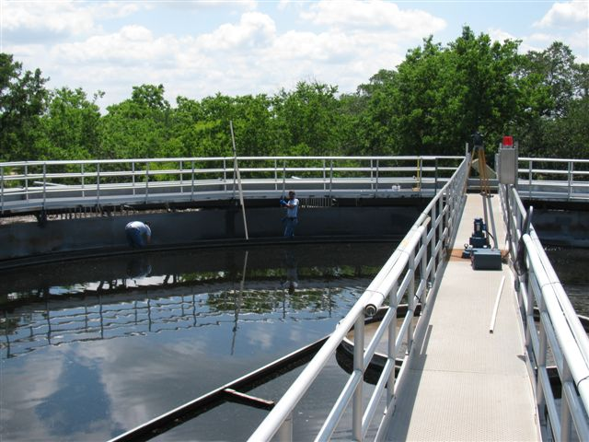
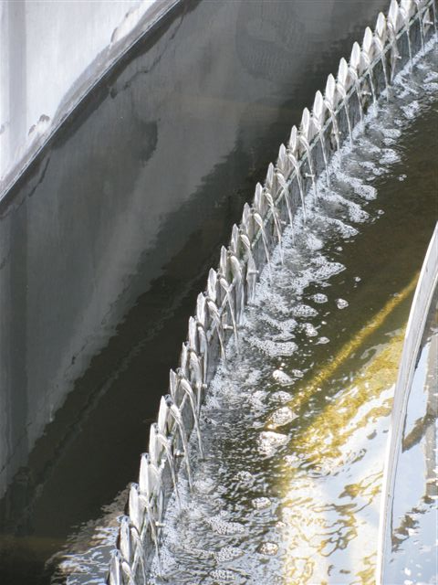
WATER WASTEWATER continued
Wastewater Treatment:
Treat influent wastewater flow, averaging approximately above 870,000 gallons daily.
Provide operation and maintenance of the wastewater treatment plant 7 days per week.
Operate and maintain 12 sand drying beds for sludge dewatering.
Operate and maintain chlorination, polymer/alum, and de-chlorination equipment.
Operate and maintain a bio-solids belt press.
Ensure that WWTP effluent discharged into the Colorado River comply with Federal/State requirements (Toxicity Characteristic Leaching Procedure, Bio monitoring and organics concentrations).
Maintain SCADA system from the wastewater treatment plant.
Department (s) Location
The Water Wastewater Department is located at 300 Water Street, Bastrop, Texas 78602.
Office hours are 7:00 AM to 4:00 PM, Monday through Friday, excluding holidays.
Operation and Service crew on call 24 hours a day.
You may contact staff by phone at (512) 332-8960.
The Water Treatment Plants are located on Willow Street and in Bob Bryant Park.

Slide 138
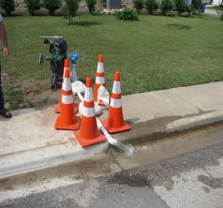
Water Wastewater Administration
Expenditure Summary | FY 2012-2013 | FY 2013-2014 | FY 2013-2014 | FY 2014-2015
Classification | Prior YTD | Original Budget | Projected YTD | Budget
Personnel Services | 870,985 | 819,670 | 730,390 | 852,022
Supplies | 54,283 | 47,210 | 43,060 | 47,210
Maintenance | 12,434 | 21,630 | 16,600 | 19,130
Occupancy | 20,299 | 19,270 | 23,400 | 23,470
Contractual Services | 876,613 | 652,870 | 656,750 | 661,420
Other Charges | 663,364 | 31,950 | 40,750 | 43,000
Contingency | 0 | 10,000 | 0 | 28,950
Capital Outlay | 0 | 0 | 0 | 0
Debt Service | 348,258 | 657,290 | 756,908 | 1,242,728
Transfers Out | 185,740 | 171,684 | 171,684 | 172,000
Total | $3,032,477 | $2,431,574 | $2,439,542 | $3,089,930
138

Slide 139
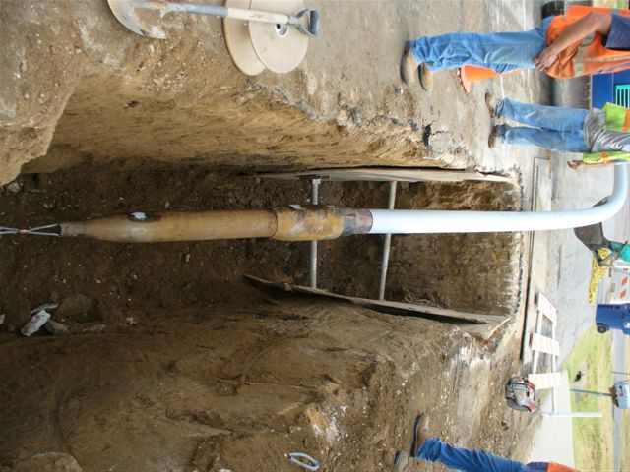
Water Wastewater Distribution, Collection & Lift Station
Expenditure Summary | FY 2012-2013 | FY 2013-2014 | FY 2013-2014 | FY 2014-2015
Classification | Prior YTD | Original Budget | Projected YTD | Budget
Personnel Services | 0 | 0 | 0 | 0
Supplies | 6,191 | 6,800 | 14,800 | 9,800
Maintenance | 154,431 | 130,000 | 127,000 | 80,400
Occupancy | 36,909 | 42,000 | 0 | 0
Contractual Services | 19,124 | 20,000 | 1,000 | 9,840
Other Charges | 0 | 1,500 | 1,000 | 1,500
Capital Outlay | 0 | 5,000 | 0 | 15,000
Total | $216,654 | $205,300 | $143,800 | $116,540

Slide 140

Water Wastewater Production, Treatment
Expenditure Summary | FY 2012-2013 | FY 2013-2014 | FY 2013-2014 | FY 2014-2015
Classification | Prior YTD | Original Budget | Projected YTD | Budget
Personnel Services | 0 | 0 | 0 | 0
Supplies | 17,861 | 23,500 | 23,000 | 28,500
Maintenance | 102,222 | 76,000 | 70,000 | 94,000
Occupancy | 84,572 | 116,000 | 116,000 | 116,000
Contractual Services | 85,645 | 96,350 | 98,300 | 126,350
Other Charges | 0 | 0 | 0 | 0
Capital Outlay | 0 | 0 | 0 | 0
Total | $385,480 | $311,850 | $307,300 | $364,850
140

Slide 141
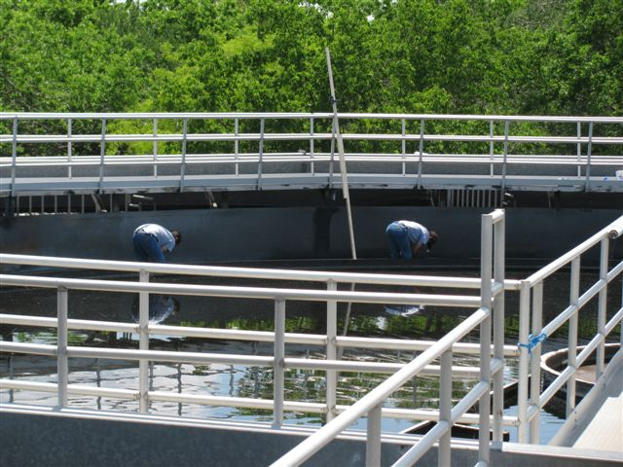
Water Wastewater Treatment Plant
Expenditure Summary | FY 2012-2013 | FY 2013-2014 | FY 2013-2014 | FY 2014-2015
Classification | Prior YTD | Original Budget | Projected YTD | Budget
Personnel Services | 0 | 0 | 0 | 0
Supplies | 31,858 | 29,800 | 29,800 | 29,800
Maintenance | 207,478 | 122,100 | 122,000 | 135,100
Occupancy | 100,271 | 80,000 | 117,800 | 117,800
Contractual Services | 55,037 | 46,000 | 59,000 | 57,000
Other Charges | 0 | 0 | 0 | 0
Capital Outlay | 0 | 0 | 0 | 0
Total | $394,643 | $277,900 | $328,600 | $339,700

Slide 142

WATER WASTEWATER continued
2013-2014 Accomplishments
Increased efficiency in operation crews by doing more maintenance work in-house resulting in fewer after hour call outs
Adjusted SCADA set points to reduce call outs
Moved water wastewater distribution crew in the same building with streets/drainage department which resulted in better communication and reduced the cost and amount of trip to complete a project.
Instituted proper flushing techniques in the distribution system
Increased training by registering with TEEX and having classes taught on site at the BP&L training facility
Successfully negotiated the start of an AMI project with the help of multiple departments
142

Slide 143

WATER WASTEWATER continued
2014-2015 Goals
Water Operations
• Continue operating and maintaining a State “Superior Water System”.
• Continue with projects described in the Capital Improvement Plan.
• Replace water line on Main Street between Spring and Pine.
• Replace infrastructure at Willow Water Plant to Main Street downtown.
• Design water tank for Highway 71 and 20.
• Optimize resources in operation and maintenance of the water system.
• Up-grade the SCADA system by adding current software and programming.
• Investigate new water sources for city’s growth demand.
• Continue with water meter replacement program.
• Maintain water loss program equal to or below 15% of unaccounted water.
Wastewater Operations
Continue certification of operators in water and wastewater.
Construct the cover for the non-potable water tank.
Construct replacement collection lines that discharge at Gill’s Branch lift station (Fayette).
Increase pipe diameter by pipe bursting on Highway 71 from SH 304 to Hasler Blvd.
Make smoke test in the city’s wastewater lines that feed Mauna Loa lift station.
Maintain in 100 % operation the SCADA system (Sewage lift stations and Wastewater Treatment Plants).
Obtain mechanical equipment for proper grease cleaning the wet wells from all City lift stations, also removal of grit in street’s manholes (vacuum tank and additional techs).
Continue with the operation and maintenance of our manholes, adding this information to our GIS.
2014-2015 Budget Objectives
Water Operations
Continue a program of ongoing education and instruction and in-house training.
Continue a program of ongoing repairs and maintenance to plant equipment and structure as necessary.
Reduce expenditures based on optimizing resources.
Improve and expand Water Conservation and Backflow Prevention Programs.
Wastewater Operations
Continue a program of ongoing education, instruction, and training in house.
Continue a program of ongoing repairs and maintenance to plant equipment and structure as necessary.
Reduce expenditures based on optimizing resources.
Oversee septic hauler discharges (approximately 1,864,947 gallons annually) to our reception location, license applications and renewals, processing manifest and monthly billing (approximately $113,971.02 annually).

Slide 144
WATER WASTEWATER continued
Performance Measurement Indicators | FY 2011-2012 | FY 2012-2013 | FY 2013-2014 | FY 2014-2015
Demand
Millions of Gallons of treated water produced | 476,704 | 486,076 | 495,797 | 495,797
Number of Connections | 2,889 | 2,970 | 3,029 | 3,029
Number of Wastewater Customers | 2,564 | 2,625 | 2,678 | 2,678
Number of Lift Stations | 18 | 18 | 18 | 18
Input
Service Area Population | 9,151 | 9,425 | 9,521 | 9,521
Output
State BAC-T Samples | 196 | 132 | 204 | 204
Leaks & Line Breaks | 69 | 254 | 259 | 259
Located Lines | 744 | 580 | 592 | 592
Flushed Lines | 310 | 420 | 428 | 428
General Customer Service | 1,257 | 2,834 | 2,890 | 2,890
Change Outs | 28 | 10 | 10 | 10
Millions of gallons of wastewater treated | 312.842 | 319,099 | 325,480 | 325,480
Sewer Stops | 43 | 176 | 180 | 180
Sewer Service | 903 | 939 | 2,048 | 2,048
Effectiveness
Number of Spills | 0 | 30 | 0 | 0
Customer Satisfaction | Good | Good | Good | Good
144

Slide 145
WATER WASTEWATER continued
Staffing Summary | FY 2011-2012 | FY 2012-2013 | FY 2013-2014 | FY 2014-2015
Public Works Director | 0 | 0 | .5 | .5
W/WW Director | 1 | 1 | 0 | 0
W/WW Assistant Director | 1 | 1 | 0 | 0
Chief Plant Operator | 1 | 1 | 1 | 1
W/WW Plant Operator | 4 | 4 | 4 | 4
W/WW Foreman | 1 | 1 | 1 | 1
System Crewleader | 0 | 0 | 1 | 1
System Technician | 4 | 4 | 4 | 4
Special Programs Coordinator | 1 | 1 | 1 | 1
Total | 13 | 13 | 12.5 | 12.5
Public Works Director
Special Programs Coordinator
W/WW Chief Plant Operator
W/WW Operator
(4)
Water/ Wastewater Foreman
Public Works Foremam
System Crewleader
System Technicians (4)
WATER WASTEWATER ORGANIZATIONAL CHART

Slide 147

ELECTRIC FUND
The City’s electric utilities are financed and operated in a manner similar to private business enterprises, where costs of providing services to the public are financed primarily through user charges. Within the Electric Fund, only one department exists: Bastrop Power and Light.
147

Slide 148

BASTROP POWER AND LIGHT
Department Description(s)
Bastrop Power & Light is responsible for the city’s 7200-volt electric distribution system. There are 25 miles of overhead electrical lines and 4 miles of underground electrical lines which provide service to approximately 2,600 electrical customers.
The department also provides support to all other departments, civic organizations, developers, contractors, electricians, property owners, and builders as needed.
Department (s) Location
The Electric Department is located at 1209 Linden Street, Bastrop, Texas.
Hours are 7:00 AM to 4:00 PM, Monday through Friday, excluding holidays.
You may contact staff by phone at (512) 332-8900.
Expenditure Summary | FY 2012-2013 | FY 2013-2014 | FY 2013-2014 | FY 2014-2015
Classification | Prior YTD | Original Budget | Projected YTD | Budget
Personnel Services | $638,663 | $643,527 | $600,330 | $588,755
Supplies | 87,307 | 64,700 | 54,420 | 50,200
Maintenance | 148,161 | 215,250 | 204,150 | 157,700
Occupancy | 14,969 | 20,060 | 17,060 | 15,500
Contractual Services | 5,020,297 | 4,995,130 | 5,408,660 | 149,310
Other Charges | 232,644 | 129,900 | 131,500 | 16,540
Capital Outlay | 0 | 115,000 | 63,200 | 135,000
Debt Service | 46,342 | 91,533 | 91,533 | 159,695
Transfers Out | 613,500 | 613,500 | 613,500 | 813,500
Total | $7,184,353 | $6,888,600 | $7,184,353 | $7,753,790

Slide 149
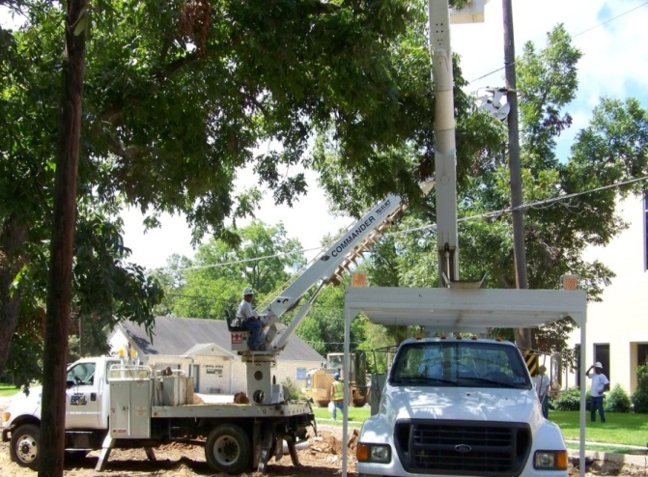
BASTROP POWER AND LIGHT continued
2013-2014 Accomplishments
• Reduced power outages due to aggressive system maintenance.
• Completed engineering and design for multiple commercial locations.
• Continued to perform all aspects of operations while adhering to strict safety guidelines.
These guidelines are reinforced through a continuous safety training program provided by
TEEX and an in-house training program.
• Continued to provide the highest level of customer service to Bastrop Power & Light customers and the citizens of Bastrop.
• Completed construction of Industrial Blvd. line re-build.
• Completed construction of Loop 150 line re-build/relocation.
• Completed construction of Chestnut Street lighting from MLK to Gills Branch.
• Completed line extension to La Hacienda for permanent power.
• Completed line extensions to Popeye’s for temporary and permanent power.
• Completed line extension to Tiger Tote #3 for temporary power.
2014-2015 Goals
Continue to provide a high quality of customer service.
Continuously work towards upgrading and maintaining a reliable quality service to all customers of Bastrop Power & Light.
Provide a prompt response to work orders.
Continue to provide employees with training to allow for increased departmental efficiency while maintaining a safe working environment.
Provide guidance to citizens, architects, builders, customers, developers, electricians, engineers, property owners and other departments regarding electrical matters.
Continue to reduce the number of power outages through aggressive system maintenance.
2014-2015 Budget Objectives
Maintain and construct a reliable utility.
Respond to customer service requests within a timely manner.
Continue operations in a fiscally responsible manner.
Continuously strive to maintain the highest level of efficiency and safety.
Provide employees with the proper equipment required to perform their jobs in an efficient and productive manner.
149

Slide 150

BASTROP POWER AND LIGHT continued
Performance Measurement Indicators | FY 2011-2012 | FY 2012-2013 | FY 2013-2014 | FY 2014-2015
Demand
Miles of Overhead Lines | 25 | 25 | 25 | 25
Miles of Underground Lines | 4 | 4 | 4 | 4
Number of Customers | 2,596 | 2,625 | 2,644
Input
Number of Employees | 9 | 9 | 9 | 9
Output
System Maintenance
Overhead | 25 | 25 | 25 | 25
Underground | 4 | 4 | 4 | 4
Construction
Line Extension | 15 | 8 | 8 | 4
Effectiveness
Customer Satisfaction | Good | Good | Good | Good

Slide 151
BASTROP POWER AND LIGHT continued
Staffing Summary | FY 2011-2012 | FY 2012-2013 | FY 2013-2014 | FY 2014-2015
Director of BP&L | 1 | 1 | 1 | 1
Electric Foreman | 2 | 2 | 2 | 2
Electric Line Worker – Journey Level | 2 | 2 | 2 | 2
Electric Line Worker - Apprentice | 2 | 2 | 2 | 2
Electric Line Worker - Trainee | 1 | 1 | 1 | 1
Administrative Assistant | 1 | 1 | 1 | 1
Total | 9 | 9 | 9 | 9
BASTROP POWER AND LIGHT ORGANIZATIONAL CHART
BP&L Director
Administrative
Assistant
Electric Foreman
(2)
Electric Line Worker – Journey Level
(2)
Electric Line Worker – Apprentice
(2)
Electric Line Worker – Trainee
(1)
151

Slide 153
Special Revenue /
Other Funds
153

Slide 154


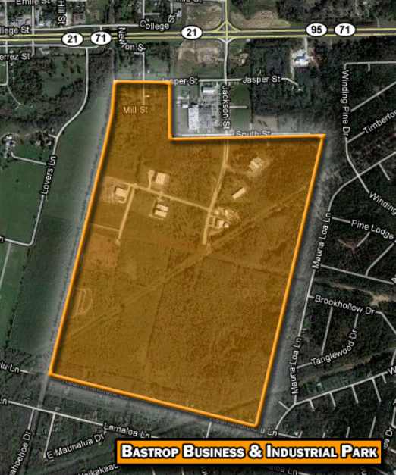

BASTROP ECONOMIC DEVELOPMENT CORPORATION
ABOUT BEDC The Bastrop Economic Development Corporation (BEDC) was established in 1995, after the citizens of Bastrop voted to pass a one-half cent sales tax dedicated to economic development. Because the organization’s primary function is to bring meaningful and rewarding employment to the citizens of Bastrop, the BEDC acquired 263 acres near the intersection of Highways 71, 21 and 95 – a prime location for potential businesses – and created the Bastrop Business & Industrial Park. Since then, several companies have either joined our community or expanded operations here, including Garments to Go, Dig Tech/Line Tech, Bluebonnet Trails MHMR, KKG Bastrop Investments, and Deep in the Heart Art Foundry, which has recently expanded their business for a third time. In May 2013, Johnson Architectural Metal Company (JAMCo) broke ground on a 40,000 facility that will serve as their new Texas headquarters. The BEDC has started the Industrial Park Infrastructure Expansion Project which will extend water, wastewater, and streets to 38 acres of the park, to accommodate the JAMCo project as well as prepare two additional shovel-ready sites for future companies to locate there. BEDC’s close association with Opportunity Austin, the Governor’s Office of Economic Development, and regional real estate partners has brought numerous prospects who are considering Bastrop for expansion or relocation.
The City of Bastrop may have a population of only 7,900, but our trade area is over 150,000 -- residents from 20 neighboring communities come here for shopping, dining, and entertainment. Not only is this good for Bastrop’s businesses, it also increases our sales tax revenue, which has more than doubled in the last 10 years!
154

Slide 155

In addition to bringing new businesses to the area, BEDC also contributes to existing companies with the Downtown Façade Renovation Grant Program. To date, BEDC has contributed nearly a half million dollars toward the renovation and restoration of over 75 Bastrop businesses, helping to preserve the historic charm of the city. BEDC’s most ambitious undertaking (aside from the Industrial Park, of course) is the Loop 150/Chestnut Street Improvement Project, which was completed in time for the opening of the new Bastrop Convention and Exhibition Center. The Chestnut Street Improvement Project included historic medallions, landscaping, underground utilities, sidewalks, historic lighting, and entryways, at a total cost of over $2 million, funded by BEDC. Additionally, BEDC helps fund parks department programs, beautification projects, parking lots, utility improvements, infrastructure development, and much more in commercial areas. In 2014, the BEDC plans to begin the Main Street Improvement Project, which will include replacing sidewalks and repaving the street to match the work completed on Chestnut Street.
As mentioned above, the BEDC is funded primarily with a one-half cent sales tax. Local sales tax is a huge portion of the City’s and Bastrop County’s budget. Did you know that if you purchase a $100 taxable item at a Bastrop retail store, the sales tax is $8.25. Of that amount, $6.25 goes to the State Comptroller for use in state government, $0.50 goes to Bastrop County to help fund roads, the sheriff’s department, etc., and $1.50 goes to the City of Bastrop. Those sales tax dollars fund streets, parks, the police and fire departments, library and economic development. Similarly, if you shop in Austin, $1.00 goes to the City of Austin and $1.00 goes to their mass transit authority. Thank you for shopping in Bastrop and helping to support our community’s progress!
In the upcoming years, the BEDC will be implementing the recommendations from the recently completed Strategic Plan. We continue to build partnerships across the region to help promote Bastrop as a tourism and recreational destination, and to promote and support local business through our “buy local” campaign, developed to increase sales tax revenue.
For 18 years, BEDC has never wavered from its mission, which is “To enhance the quality of life in Bastrop, by providing appropriate infrastructure and by promoting and assisting the kind of economic development in our community which will provide the people of Bastrop meaningful and rewarding employment opportunities and greater access to desirable goods and services.” For more information about the Bastrop Economic Development Corporation, please contact the BEDC office at (512) 303-9700.
155

Slide 156
BASTROP ECONOMIC DEVELOPMENT CORPORATION FUND
FY 2014-2015 BUDGET
 | Projected Fund Balance 9-30-2014 |  |  |  |  |  |  | $ 2,366,890
 | FY 2014-2015
 | Budgeted Revenues |  |  |  |  |  |  | $ 1,790,650
 | Total FY 2015 Resources |  |  |  |  |  |  | $ 4,157,540
 | Budgeted Expenditures: |  |  |  |  |  |  | $ (1,790,650)
 | Projected Ending Gross Fund Balance 09-30-2015 |  |  |  |  |  |  | $ 2,366,890
156

Slide 157
BEDC Fund Expenditures
FY 2014-2015
$ 1,790,650
BASTROP ECONOMIC DEVELOPMENT CORPORATION continued
BEDC Fund Revenues
FY 2014-2015
$ 1,790,650
157

Slide 158
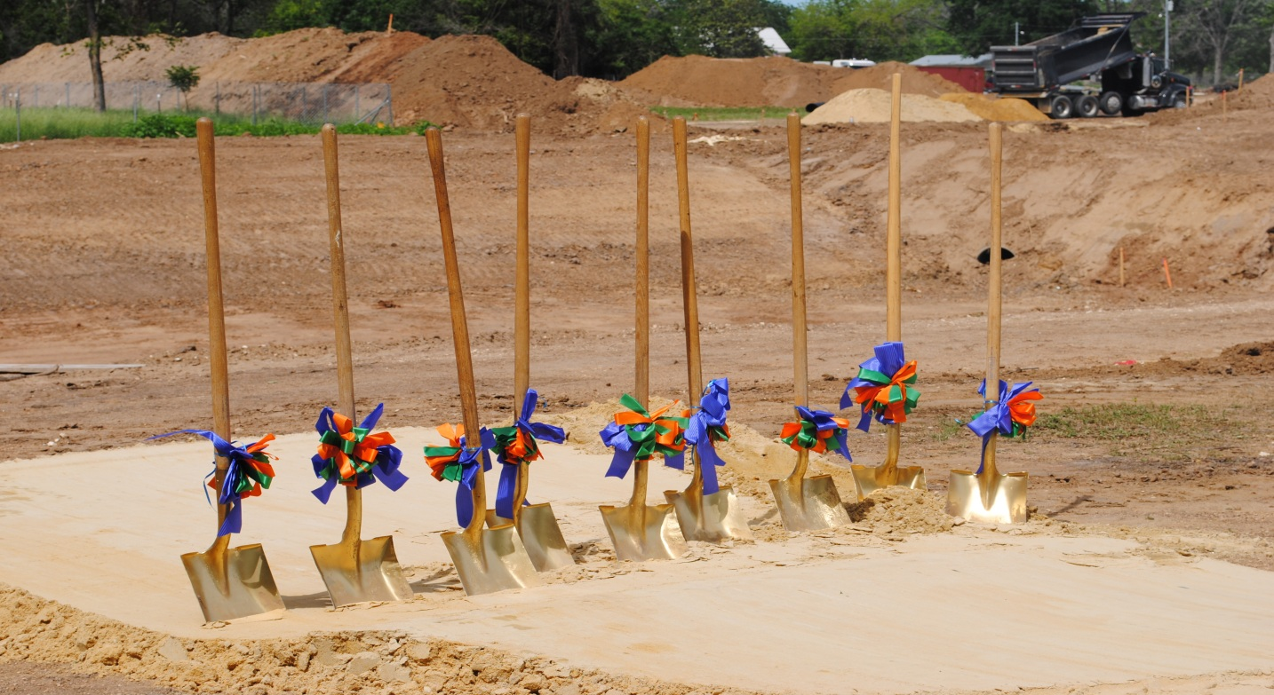
BASTROP ECONOMIC DEVELOPMENT CORPORATION continued
Performance Measurement Indicators | FY 2011-2012 | FY2012-2013 | FY2013-2014 | FY2014-2015
Demand
City Population | 7,500 | 7,650 | 7,800 | 7,950
Input
Operating Expenditures | $1,387,427 | $1,486,700 | $1,653,100 | $1,790,650
Total Number of Personnel (FTE) | 2 | 2 | 2 | 2
Output
City Taxable Assessed Value | $627,256,816 | $635,808,461 | $670,721,248 | $737,922,965
Efficiency
City Taxes | $0.584 | $0.584 | $0.584 | $0.564
ISD Taxes | $1.4810 | $1.4810 | $1.461 | $1.4410
Bastrop County Taxes | $0.4979 | $0.5168 | $0.5155 | $0.5156
County Road Taxes | $0.1196 | $0.1146 | $.1135 | $.1134
158

Slide 159
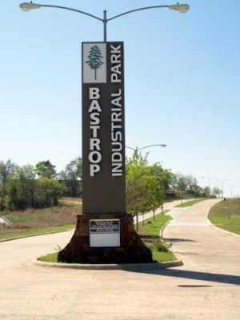
BASTROP ECONOMIC DEVELOPMENT CORPORATION continued
Staffing Summary | FY 2011-2012 | FY 2012-2013 | FY 2013-2014 | FY 2014-2015
Director of BEDC | 1 | 1 | 1 | 1
Administrative Assistant | 1 | 1 | 1 | 1
Total | 2 | 2 | 2 | 2
BASTROP ECONOMIC DEVELOPMENT CORPORATION
ORGANIZATIONAL CHART
BEDC Director
Administrative
Assistant
159

Slide 160
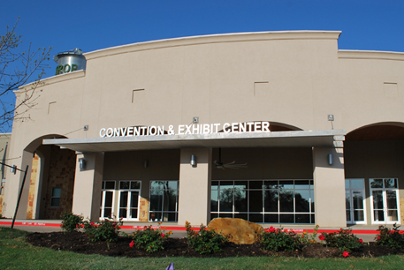

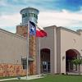
BASTROP CONVENTION AND EXHIBIT CENTER
Located 25 miles east of Austin, the City of Bastrop's new Convention & Exhibit Center is nestled in the heart of the Bastrop Historic District and beautiful Main Street area along the Colorado River. Opened in the Spring of 2011, this full-service facility is ready to host your convention, trade show, corporate meeting, wedding, concert, arts event, or banquet—just to name a few. The 26,000 square foot Convention & Exhibit Center hosts the latest technological amenities, that can accommodate up to 750 banquet-style seating and 890 theater-style seating in a flexible Main Ballroom. The Center also includes a Bridal Room, multiple meeting rooms, and additional outdoor venue space. This attractive facility is ideally affordable to state associations, event planners, trade show producers and brides. Local accommodations for overnight visitors include Hotels, Historic Bed & Breakfasts and a Four-Diamond Resort. Specialty shops, museums, historic sites, local restaurants and nature based activities await those visiting the Convention & Exhibit Center and Bastrop, Texas.
For whatever type of event you're planning, from a small board meeting to a large trade show, from a formal banquet to an elegant wedding, the Bastrop Convention & Exhibit Center's ample size and versatile space can be tailored to meet your needs perfectly. We have the facility, staff, services and equipment to make any event a complete success.
160

Slide 161

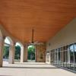
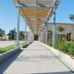
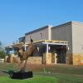
CONVENTION CENTER FUND #502
FY 2014-2015 BUDGET
Projected Fund Balance 9-30-2014 |  |  |  |  |  | $ 901,988
FY 2014-2015
Budgeted Revenues:
Operating Revenue |  |  |  |  |  | $ 154,000
Interest Income |  |  |  |  |  | $ 2,000
Transfer In - Hotel #501 - M&O |  |  |  |  |  | $ 570,275
Transfer In - Hotel #501 – Debt |  |  |  |  |  | $ 551,025
Total FY2015 Revenues |  |  |  |  |  | $ 1,277,300
Budgeted Expenditures:
Operating Expenses |  |  |  |  |  | $ (808,735)
Debt Service Payments |  |  |  |  |  | $ (551,025)
Total FY 2015 Expenditures |  |  |  |  |  | $ (1,359,760)
Projected Ending Fund Balance 9-30-2015 |  |  |  |  |  | $ 819,528
161

Slide 162
Bastrop Convention and Exhibit Center Fund Expenditures
FY 2014-2015
$ 1,359,760
Bastrop Convention and Exhibit Center Fund Revenues
FY 2014-2015
$ 1,277,300
162

Slide 163
BASTROP CONVENTION AND EXHIBIT CENTER continued
Staffing Summary | FY 2011-2012 | FY 2012-2013 | FY 2013-2014 | FY 2014-2015
Director of Center | 1 | 1 | 1 | 1
Administrative Assistant | 1 | 1 | 1 | 1
Maintenance Worker II | 1 | 1 | 1 | 1
Custodian | 1 | 1 | 1 | .5
Event Coordinator | 0 | .2 | .2 | 1
Total | 4 | 4.2 | 4.2 | 4.5
ORGANIZATIONAL CHART
Convention Center Director
Administrative
Assistant
Maintenance Worker II
Custodian
Event Coordinator
163

Slide 164
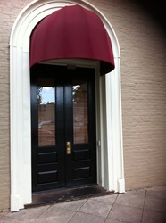
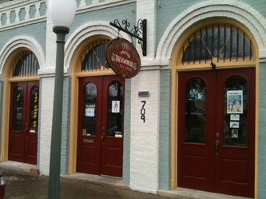
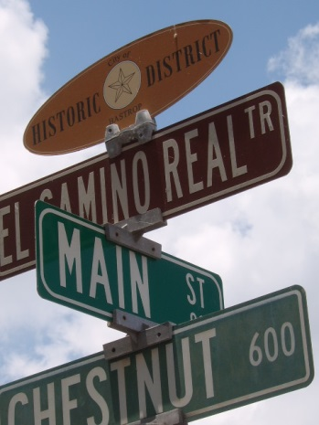
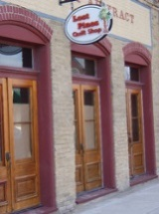
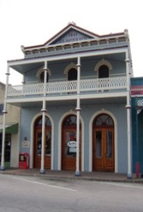




MAIN STREET PROGRAM
Department Description
The Bastrop Main Street Program is an historic preservation and economic restructuring program which focuses on the historic downtown corridors of Chestnut Street and Main Street. The program’s vision is the continuing revitalization of our historic downtown, the Heart of the Lost Pines, where families, friends and visitors live, work and enjoy our rich heritage. The mission of the program is to revitalize our historic downtown, to positively impact its economic and social health, and to preserve our heritage and promote our future through effective use of community and personal resources within the Four Points approach of organization, design, economic restructuring and promotions.
Location
Main Street Program is located at 1408 Chestnut Street, Bastrop, Texas 78602.
Hours are 8:00 AM to 5:00 PM, Monday through Friday, excluding holidays.
You may contact us by phone at (512) 332-0068 or (512) 297-5382 (cell).
164

Slide 165
MAIN STREET PROGRAM FUND #503
FY 2014-2015 BUDGET
Projected Fund Balance 9-30-2014 |  |  |  |  |  | $ 40,997
FY 2014-2015
Budgeted Revenues |  |  |  |  |  | $ 125,300
Total FY 2015 Resources |  |  |  |  |  | $ 166,297
Budgeted Expenditures:
General Operating |  |  |  |  |  | $ (107,305)
Advertising/ Promotional |  |  |  |  |  | $ ( 42,550)
Total Budgeted Expenditures |  |  |  |  |  | $ (149,855)
Projected Fund Balance 9-30-2015 |  |  |  |  |  | $ 16,442
165

Slide 166

MAIN STREET PROGRAM continued
Staffing Summary | FY 2011-2012 | FY 2012-2013 | FY 2013-2014 | FY 2014-2015
Director of Main Street Program | 1 | 1 | 1 | 1
Total | 1 | 1 | 1 | 1
ORGANIZATIONAL CHART
Main Street Director
166

Slide 167
167

Slide 168
Special Revenue/ Other Funds include:
W-WW Impact Fee Fund
W-WW Acceleration Fee Fund
Hotel Motel Tax Revenue Fund
Library Board Fund
Park/ Trail Land Dedication Fund
Fairview Cemetery Fund
Designated Fund
Arts in Public Places
Sanitation Fund

Slide 169
W-WW IMPACT FEE FUND #303
FY 2014-2015 BUDGET
Projected Fund Balance 9-30-2014 |  |  |  |  |  | $ 895,177
FY 2014-2015
Budgeted Revenues: |  |  |  |  |  | $ 51,000
Budgeted Expenditures |  |  |  |  |  | $ (50,000)
Projected Ending Fund Balance 9-30-2015 |  |  |  |  |  | $ 896,177
169

Slide 170
W-WW ACCELERATION RECOVERY FEES #304
FY 2014-2015 BUDGET
Projected Fund Balance 9-30-2014 |  |  |  |  |  | $ 713,377
FY 2014-2015
Budgeted Revenues:
Acceleration Fees |  |  |  |  |  | $ 139,265
Interest Income |  |  |  |  |  | $ 750
Transfers In from W/WW Fund |  |  |  |  |  | $ 172,000
Total FY 2014 Resources |  |  |  |  |  | $ 312,015
Budgeted Expenditures |  |  |  |  |  | $ (310,226)
Projected Ending Fund Balance 9-30-2015 |  |  |  |  |  | $ 715,166

Slide 171
171
HOTEL/ MOTEL TAX FUND #501
FY 2014-2015 BUDGET
Projected Fund Balance 9-30-2014 |  |  |  |  | $ 2,037,807
FY2014-2015
Budgeted Revenues: |  |  |  |  | $ 2,647,000
Total FY 2014 Resources |  |  |  |  | $ 4,684,807
Budgeted Expenditures:
Organizational Partnership Funding |  |  |  |  | $ (300,000)
Bastrop Marketing Corporation |  |  |  |  | $ (914,529)
Bastrop Main Street Program |  |  |  |  | $ (75,000)
Special Event Expenses |  |  |  |  | $ (45,000)
Bastrop Arts in Public Places (BAIPP) |  |  |  |  | $ (40,159)
Transfer Out-Convention Center-M&O |  |  |  |  | $ (570,275)
Transfer Out-Convention Center-Debt Payments |  |  |  |  | $ (551,025)
Total FY 2015 Expenditures |  |  |  |  | $ (2,495,988)
Projected Ending Fund Balance 9-30-2015 |  |  |  |  | $ 2,188,819
171

Slide 172

LIBRARY BOARD FUND #505
FY 2014-2015 BUDGET
Projected Fund Balance 9-30-2014 | $ 7,777
FY 2014-2015
Budgeted Revenues | $ 2,540
Budgeted Expenditures | $ (2,930)
Projected Ending Fund Balance 9-30-2015 | $ 7,387

Slide 173
PARK/TRAIL LAND DEDICATION FUND #520
FY 2014-2015 BUDGET
Projected Fund Balance 9-30-2014 |  |  |  |  |  |  | $ 119,855
FY 2014-2015
Budgeted Revenues |  |  |  |  |  |  | $ 200
Budgeted Expenditures |  |  |  |  |  |  | $ (110,400)
Projected Ending Fund Balance 9-30-2015 |  |  |  |  |  |  | $ 9,655
173

Slide 174
FAIRVIEW CEMETERY OPERATING FUND #525
FY 2014-2015 BUDGET
Projected Fund Balance 9-30-2014 |  |  |  |  | $ 246,366
FY 2014-2015
Budgeted Revenues |  |  |  |  | $ 78,750
Budgeted Expenditures |  |  |  |  | $ (155,660)
Projected Ending Fund Balance 9-30-2015 |  |  |  |  | $ 169,456
FAIRVIEW CEMETERY PERMANENT FUND #526
Projected Fund Balance 9-30-2014 |  |  |  |  | $ 383,649
FY 2015 Current Estimated Revenues |  |  |  |  | $ 0
Projected Ending Fund Balance 9-30-2015 |  |  |  |  | $ 383,649

Slide 175
DESIGNATED FUND
FY 2014-2015 BUDGET
Projected Fund Balance 9-30-2014 | $ 795,110
FY 2014-2015
Budgeted Revenues | $ 798,100
Total Budgeted Expenditures | $ (771,000)
Projected Ending Fund Balance 9-30-2015 | $ 822,210
Designated Fund Revenue
175

Slide 176
176
ARTS IN PUBLIC PLACES FUND #504
FY 2014-2015 BUDGET
Projected Fund Balance 9-30-2014 | $ 34,171
FY 2014-2015
Budgeted Revenues | $ 40,159
Budgeted Expenditures | $ (74,330)
Projected Ending Fund Balance 9-30-2015 | $ 0

Slide 177
177
SANITATION FUND #310
FY 2014-2015 BUDGET
Projected Fund Balance 9-30-2014 |  |  |  |  |  | $ 0
FY 2014-2015
Budgeted Revenues: |  |  |  |  |  | $ 457,500
Budgeted Expenditures |  |  |  |  |  | $ (457,500)
Projected Ending Fund Balance 9-30-2015 |  |  |  |  |  | $ 0

Slide 178

178

Slide 179
Debt Service
179

Slide 180
180

Slide 181
190

Slide 182
Appendices

Slide 183
192

Slide 184
Capital Improvement Projects
Work in Progress
FY 2014-2015
Street Improvements:
Farm Street
Chambers Street
Pecan Street
In-House Street Repair
Street Equipment
Water/ Wastewater Improvements:
Water Supply Infrastructure Improvements
Water System Development and Improvements
Wastewater System Rehabilitation
Water Wastewater Treatment Plant Phase 1
Gils Branch Lift Station Relocation
Electrical System Improvements
Other Projects:
Advanced Metering Infrastructure Project
Main Street Sidewalk and Street Replacement
Alley “D” Infrastructure and Parking Improvements

Slide 185
194

Slide 186
Glossary of Terms
Account Number: A code made up of numbers used to classify how specific dollar amounts come into the City or how they are being spent.
Accounting System: The methods and records established to identify, assemble, analyze, classify, record, and report the City’s transactions and to maintain accountability for the related assets and liabilities.
Accounts Payable: A short-term (one year or less) liability reflecting amounts owed for goods and services received by the City.
Accounts Receivable: An asset reflecting amounts due from other persons/organizations for goods and services furnished by the City.
Accrual Basis of Accounting: A basis of accounting in which revenues and expenses are recorded at the time they occur, rather than at the time cash is received or paid by the City.
Ad Valorem Taxes: The charges levied on all real and certain personal property according to the property’s assessed value and the tax rate. Also known as property taxes.
Amortize: To provide for the gradual extinguishment of a liability (as a mortgage) usually by contribution to a sinking fund at the time of each periodic payment.
Appropriation: An authorization made by the City Council which permits the City to make expenditures and incur obligations.
Assessed Value: A valuation set upon real estate or other property as a basis for levying property taxes. All property values within the City of Bastrop are assessed by the Bastrop Central Appraisal District.
Asset: The resources and property of the City that can be used or applied to cover liabilities.
Audit: A comprehensive examination as to the manner in which the government’s resources were actually utilized, concluding in a written report. A financial audit is a review of the accounting system and financial information to determine how government funds were spent and whether expenditures were in compliance with the legislative body’s appropriations. A performance audit consists of a review of how well the government met its stated goals. The City is required to have an annual financial audit conducted by a qualified certified public accountant.
Available Cash: Unobligated cash and cash equivalents.
Balance Sheet: A financial statement that discloses the assets, liabilities, reserves, and balances of a specific governmental fund as of a specific date.

Slide 187
Glossary of Terms continued
Bond: A written promise to pay a specified sum of money (called the principal amount) at a specified date or dates in the future (called the maturity dates) and carrying interest at a specified rate, usually paid periodically. The difference between a bond and a note is that a bond is issued for a longer period and requires greater legal formality. The most common types of bonds are general obligation and revenue bonds. Bonds are usually used for construction of large capital projects such as buildings, streets and water/wastewater system improvements.
Bonded Debt: The portion of indebtedness represented by outstanding (unpaid) bonds.
Bonds Issued: Bonds sold by the City.
Bonds Payable: The face value of bonds issued and unpaid.
Budget: A financial plan for a specified period of time (fiscal year for the City) that includes an estimate of prepared expenditures and the means for financing them.
Budget Year: From October 1st through September 30th, which is the same as the fiscal year.
Budgetary Basis of Accounting: The method used to determine when revenues and expenses are recognized for budgetary purposes.
Budgetary Control: The control or management of a governmental unit or enterprise in accordance with an approved budget for the purpose of keeping expenditures within the limitations of available appropriations and available revenues.
Capital Improvements: Expenditures for the construction, purchase or renovation of City facilities or property.
CIP: Capital Improvement Program. A plan for capital expenditures to provide long-lasting physical improvements to be incurred over a fixed period of several future years.
Capital Outlay: Expenditures resulting in the acquisition of or addition to the City’s fixes assets.
Capital Projects Fund: A fund created to account for financial resources to be used for the acquisition or construction of major capital facilities or equipment.
Cash: Current on hand and demand deposits with financial institutions.
Certificate of Obligation (C.O.): Legal debt instruments used to finance capital improvement projects. Certificates of obligation are backed by the full faith and credit of the government entity and are fully payable from a property tax levy. Certificates of obligation differ from general obligation debt in that they are approved by the City Council and are not voter approved.
196

Slide 188
Glossary of Terms continued
Contingency: The appropriation of funds for future allocation in the event specified budget allocations are insufficient and additional funding is required.
Current Taxes: Taxes that are levied and due within the ensuing fiscal year.
Debt Service: The payment of principal and interest on borrowed funds.
Debt Service Fund: A fund established to account for funds needed to make principal and interest payments on outstanding bonds when due. Also referred to as an Interest and Sinking (I&S) Fund.
Debt Service Requirements: The amount of money required to pay interest and principal for a specified period on outstanding debt.
Delinquent Taxes: Property taxes remaining unpaid after the due date. Delinquent taxes incur penalties and interest at rates specified by law.
Department: A functional group of the City with related activities aimed at accomplishing a major City service or program.
Division: A grouping of related activities within a particular department. For example, Animal Control is a division of the Police Department.
Effective Tax Rate: The rate that produces the same effect in terms of the total amount of taxes as compared to the prior year. The computation of the effective rate is governed by the State of Texas.
Encumbrance: The commitment of appropriated funds to purchase an item or service. An encumbrance differs from an account payable in that a commitment is referred to as an encumbrance before the goods or services are received. After receipt, the commitment is referred to as an account payable.
Equity: The difference between assets and liabilities of the fund.
Estimated Revenue: The amount of revenue expected to be collected during the year.
Expenditure: If accounts are kept on the accrual basis, this term designates total charges incurred whether paid or unpaid. If they are kept on the cash basis, the term covers only actual disbursements for these purposes. (Note: An encumbrance is not an expenditure. An encumbrance reserves funds to be expended)
Expense: Charges incurred, whether paid or unpaid, for operation, maintenance, interest and other charges which are presumed to benefit the current fiscal period.

Slide 189
Glossary of Terms continued
Fiscal Year (Period): The time period designated by the City signifying the beginning and ending period for recording the financial transactions of the City. The City of Bastrop’s fiscal year begins each October 1st and ends the following September 30th.
Fixed Assets: Assets of a long-term character which are intended to be held or used, such as land, buildings, machinery, furniture and equipment.
Franchise Fee: A fee paid by public service businesses for use of City streets, alleys and property in providing their services to citizens of a community. Services requiring franchises include electricity, telephone, natural gas, water, wastewater and cable television.
Full Faith and Credit: A pledge of the City’s taxing power to repay debt obligations. Bonds carrying such pledges are referred to as general obligation bonds or tax-supported debt.
Full Time Equivalent (F.T.E.): A quantifiable unit of measure utilized to convert hours worked by part-time, seasonal or temporary employees into hours worked by full-time employees. Full-time employees work 2080 hours annually. A part-time employee working 1040 hours annually represents a 0.5 F.T.E.
Fund: Separate fiscal and accounting entities with their own resources and budgets necessary to carry on specific activities and attain certain objectives.
Fund Balance: The difference between fund assets and fund liabilities of governmental & trust funds. Fund balance for general fund types using modified accrual accounting closely equates to available cash.
GAAP: Generally Accepted Accounting Principles.
General Fund: Accounts for all financial resources except those required to be accounted for in another fund. The General Fund contains the activities commonly associated with municipal government such as police and fire protection, libraries, streets, parks and recreation.
General Obligation Bonds: Bonds that finance a variety of public projects such as streets, building and capital improvements. The repayment of these bonds is usually made from the Debt Service Fund. They are backed by the full faith and credit of the City, and are voter approved.
General Obligation Debt: The supported bonded debt which is backed by the full faith and credit of the City.
Goals: Department/division objectives intended to be accomplished or begun within the coming fiscal year.
198

Slide 190
Glossary of Terms continued
Line Item Budget: A budget that lists each expenditure category (salary, materials, telephone service, travel, etc.) separately along with the dollar amount budgeted for each specified category.
Limited Tax Note: Short-term interest-bearing note issued by a government in anticipation of tax revenues to be received at a later date. The note is retired from the tax revenues to which it is related.
Long-Term Debt: Any un-matured debt that is not a fund liability with a maturity of more than one year.
Maintenance: The act of keeping assets in a state of good repair. It includes preventive maintenance, normal periodic repairs, part replacement and so forth needed to maintain the asset so that it continues to provide normal service.
Mission: The basis purpose of the department/division – the reason for its existence.
Non-Operating Expenditures: The costs of government services which are not directly attributable to a specific City program or operation. An example includes debt service obligations.
Non-Operating Revenues: The incomes not received by the government which are not directly attributable to providing a service. An example would be interest on investments.
Governmental Fund: Refers to the General Fund, all Special Revenue Funds and the Debt Service Fund.
Grant: Contributions or gifts of cash or other assets from another government to be used for a specific purpose, activity or facility.
Indirect Costs: Those costs that are fully expensed within one fund or division that can be allocated to another fund or division; Human Resources is fully expensed to the General Fund but services relate to the Electric Utility Fund as well.
Infrastructure: Long-lived capital assets that normally are stationary in nature and can be preserved for a significantly greater number of years than most capital assets. Examples of infrastructure assets include roads, bridges, drainage systems and water and wastewater systems.
Interest and Sinking Fund: See Debt Service Fund.
Inter-fund Transfers: Amounts transferred from one fund to another.
Intergovernmental Revenue: Revenues received from another governmental entity, such as county, state or federal governments.
Inventory: A detailed listing of property currently held by the City.
Levy: To impose taxes, special assessments or service charges for the support of City activities.

Slide 191
Glossary of Terms continued
O&M: Operations and Maintenance.
Objectives: A specific, measurable and observable result of an organization’s activity which advances the organization toward a goal.
Operating Budget: Plans of current expenditures and the proposed means of financing them. The annual operation budget is the primary means by which most of the financing activities of the City are controlled.
Operating Expenses: Proprietary fund expenses related directly to the fund’s primary activities.
Operating Income: The excess of operating revenues over operating expenses.
Operating Revenues: Proprietary fund revenues directly related to the fund’s primary activities. They consist primarily of user charges for goods and services.
Operating Transfers: Legally authorized transfers from a fund receiving revenue to the fund through which the resources are to be expended.
Ordinance: A formal legislative enactment by the City Council.
Paying Agent: An entity responsible for paying of bond principal and interest on behalf of the City.
Policy: A plan, course of action or guiding principle design to set parameters for decisions and actions.
Principal: The face value of a bond, payable on stated dates of maturity.
Property Taxes: See Ad Valorem Taxes.
Proprietary Fund: Also referred to as an Enterprise Fund. A governmental accounting fund in which the services provided, such as water and wastewater service, are financed and operated similarly to those in a private business. The intent is that the costs of providing these services be recovered through user charges (e.g. water/wastewater bills).
Refunding: The issuance of new debt whose proceeds are used to repay previously issued debt. The proceeds may be used immediately for this purpose (a current refunding) or they may be placed with an escrow agent and invested until they are used to pay principal and interest on the old debt at a future time (an advanced refunding).
Reimbursements: Inter-fund transactions that constitute reimbursements to a fund for expenditures or expenses initially made from it, but that properly apply to another fund.
Reserve: An account used to indicate that a portion of a fund’s balance is legally restricted for a specific purpose and is, therefore, not available for general appropriation.
200

Slide 192
Glossary of Terms continued
Resolution: A special or temporary order of the City Council. Requires less formality than an ordinance.
Retained Earnings: An equity account reflecting the accumulated earning of a proprietary fund.
Revenue: All money received by a government other than expense refunds, capital contributions and residual equity transfers.
Revenue Bonds: Bonds whose principal and interest are payable exclusively from the earnings of a proprietary fund.
Risk Management: An organized effort to protect the City’s assets against loss, utilizing the most economical methods.
Special Revenue Fund: Accounts for the proceeds of specific revenue sources that are legally restricted to expenditure for specified purposes.
Taxable Value: The assessed value of property less any exemptions available on that specific property. The tax rate is applied to the taxable value to arrive at a tax levy.
Tax Base: The total taxable value of all real and personal property in the City as of January 1st of each year as certified by the Tax Appraisal District, less any exemptions.
Tax Levy: The resultant product when the tax rate per one hundred dollars is multiplied by the tax base.
Tax Rate: The amount of tax levied for each $100 of taxable value.
Tax Roll: The official list showing the amount of taxes levied against each taxpayer of property.
Taxes: Compulsory charges levied by a government to finance services performed for the common benefit.
TML: The Texas Municipal League is a voluntary coalition of Texas municipalities created for the purpose of furthering and enhancing causes of mutual interest to Texas cities. The League offers education and training opportunities, legislative activities and legal advisement to its members. Additionally, the League has intergovernmental risk pools that offer insurance coverage on an elective basis.
TMRS: The Texas Municipal Retirement System provides retirement plans to its member cities. Each city selects its own plan and its contributions are computed on each individual city’s plan and actuarial information. The City of Bastrop currently offers its employees a retirement plan with 2:1 matching, 5 year vesting and retirement eligibility at age 60 with 5 years of service and at any age with 25 years of service.
Working Capital: Current assets less current liabilities.

Slide 193
202

Slide 194
2014-2015 Ordinances
Adopting Budget and Tax Rate

Slide 195
Departmental Budget
Reports
204

